Slide 1

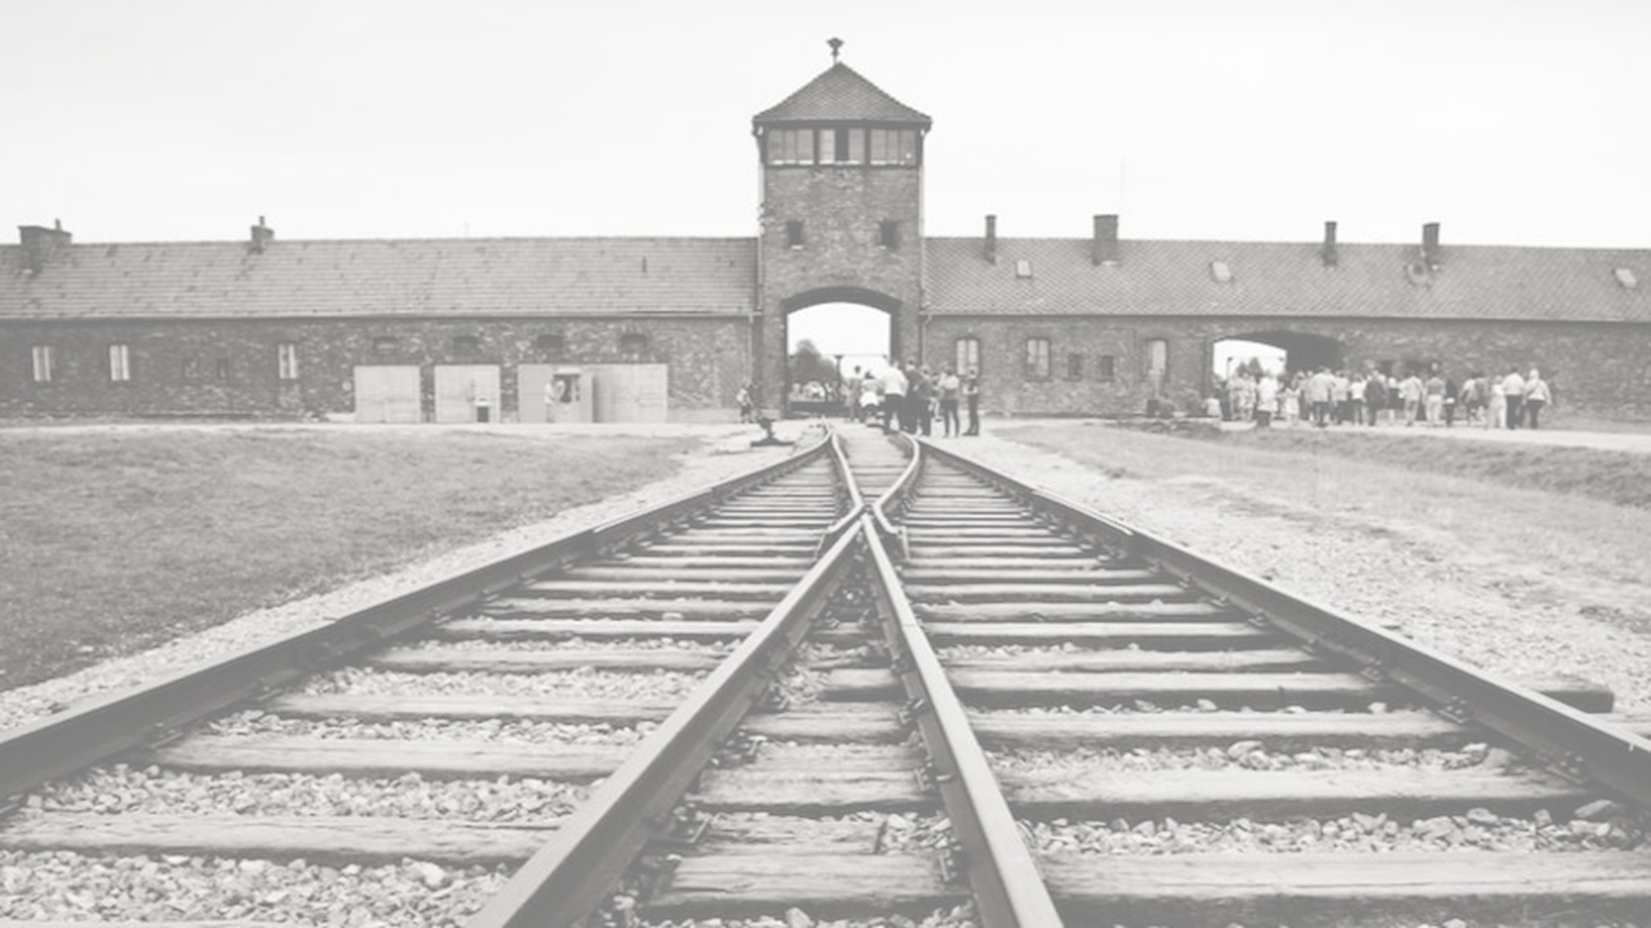





1939-1945
Chapter 26
THE HOLOCAUST
the holocaust
Strand Three: The History of Europe and the Wider World
@MsDoorley

Slide 2
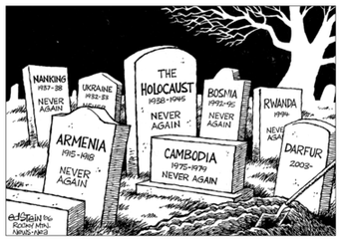
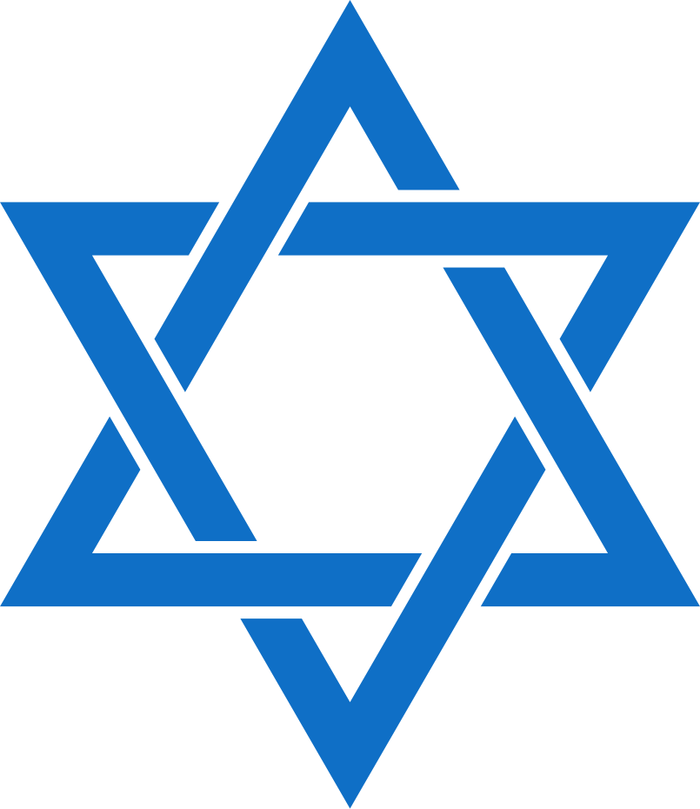
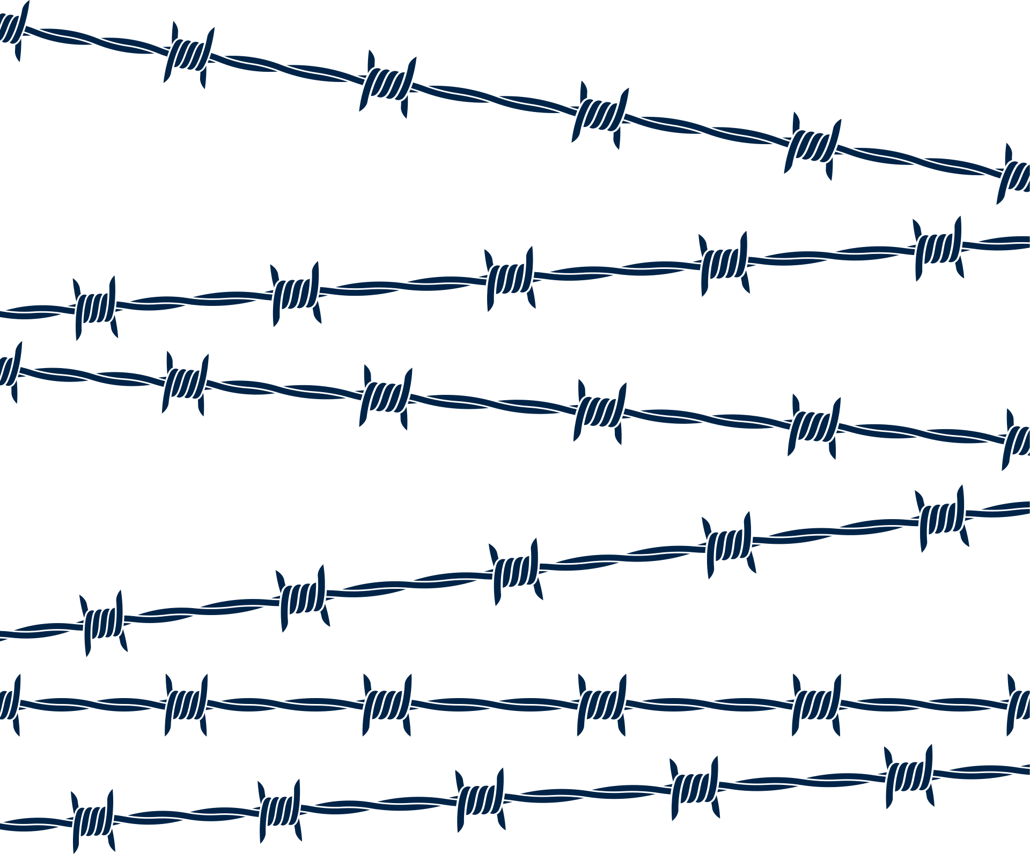
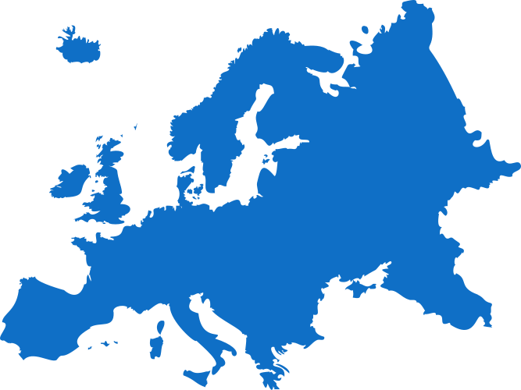

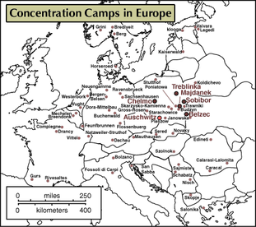
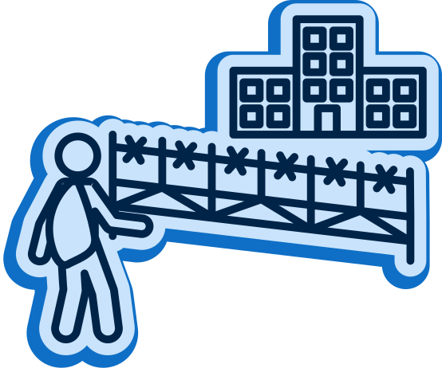



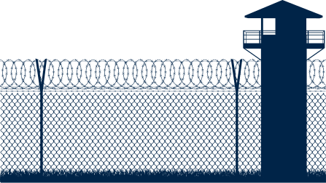
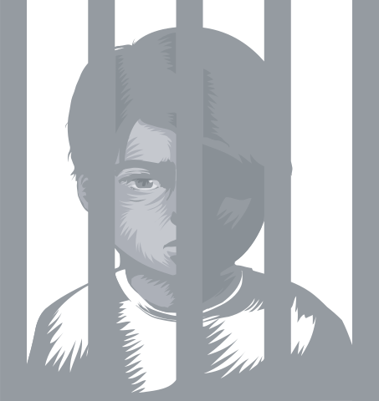
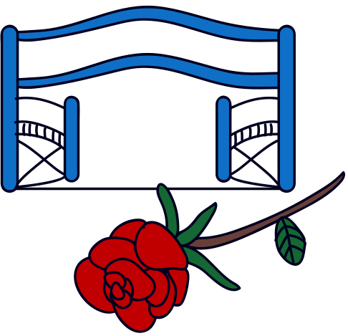
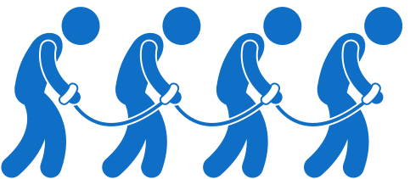
Chapter 26
THE HOLOCAUST
3.10 EXPLORE the significance of genocide, including the causes, course and consequences of the Holocaust
The first Concentration Camp is opened at Dachau.
Kristallnacht (The Night of the Broken Glass); hundreds of Jewish properties and business are destroyed.
The Final Solution is discussed, and actions are taken to implement the plan.
Strand Three: The History of Europe and the Wider World
Chapter Twenty-Six: The Holocaust
Jan 1933
Apr 1933
1935
1938
1941
1942
1945
Adolf Hitler becomes the Chancellor of Germany.
The Nuremberg Laws are put in place, stripping Jews of numerous rights.
Establishment of Auschwitz II (Birkenau) for the extermination of "undesirables"
Auschwitz is liberated by the Soviet Red Army
@MsDoorley

Slide 3
Learning Outcomes
3.10 EXPLORE the significance of genocide, including the causes, course and consequences of the Holocaust.
Strand Three: The History of Europe and the Wider World
Chapter Twenty-Six: The Holocaust
@MsDoorley

Slide 4
Introduction
Throughout history, there have been many examples of genocide, the attempt to eliminate entire peoples, or religious or ethnic groups. The most studied example is the Holocaust, in which Hitler and the Nazis aimed to systematically wipe out the entire European population of Jewish people. In this chapter, you will learn about this horrific period of history and look at other examples of genocide: those of Native Americans, the people of Armenia, Cambodia and Rwanda.
Strand Three: The History of Europe and the Wider World
Chapter Twenty-Six: The Holocaust
@MsDoorley

Slide 5
What is Genocide?
Tens of millions of men, women and children have lost their lives to genocide or mass atrocities over the last few centuries. Genocide is defined as “the deliberate killing of a large number of people from a particular nation or ethnic group with the aim of destroying that nation or group.” Some of these attempts have been backed and organised by governments while others have seemed spontaneous. All of them began with the process of dehumanisation – treating people as they were (are) somehow less than human.
According to the United Nations, 'Genocide is a denial of the right of existence of entire human groups' and 'is a crime under international law.... whether the crime is committed on religious, racial, political or any other grounds'.
Strand Three: The History of Europe and the Wider World
Chapter Twenty-Six: The Holocaust
@MsDoorley

Slide 6
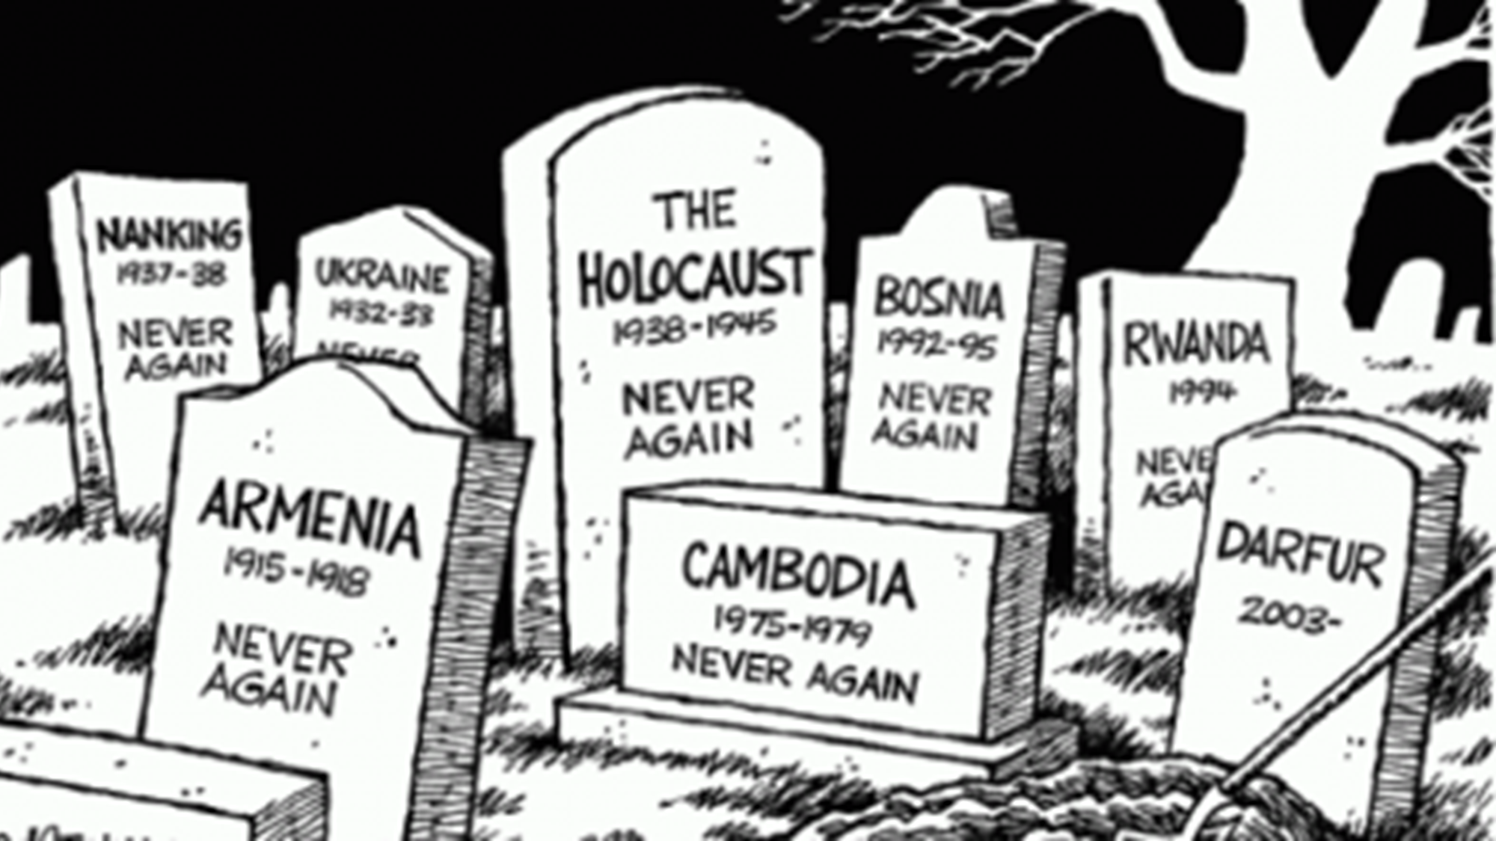
Strand Three: The History of Europe and the Wider World
Chapter Twenty-Six: The Holocaust
Diagram taken from Artefact, 1st Edition by Eimear Jenkinson and Gregg O'Neill (educate.ie)
@MsDoorley

Slide 7


1939-1945
Chapter 26
26.1: GENOCIDES BEFORE THE HOLOCAUST
26.1: genocides before the holocaust
Strand Three: The History of Europe and the Wider World
@MsDoorley

Slide 8
Genocides of Native Americans
Numerous atrocities (severe crimes) have been committed against Native Americans over several centuries. When European explorers first arrived in modern day USA, it is estimated 10 million Native Americans were living there. By the early 20th Century, that number had fallen to under 300,000.
European expansion into North America directly led to the destruction of Native American livelihoods. Unfamiliar diseases such as measles, influenza, and whooping cough. Malnutrition as tribes were forced from their traditional land and food sources. Tribal villages were ambushed during the gold rushes of the eighteenth and nineteenth centuries. Several wars broke out between native tribes and settlers.
In modern-day USA, laws exist to protect some 500 tribes that survived. Each tribe has a distinct culture, way of life and history. Despite these laws in place, Native Americans still face major challenges such as poverty, cultural losses and discrimination.
Strand Three: The History of Europe and the Wider World
Chapter Twenty-Six: The Holocaust
@MsDoorley

Slide 9
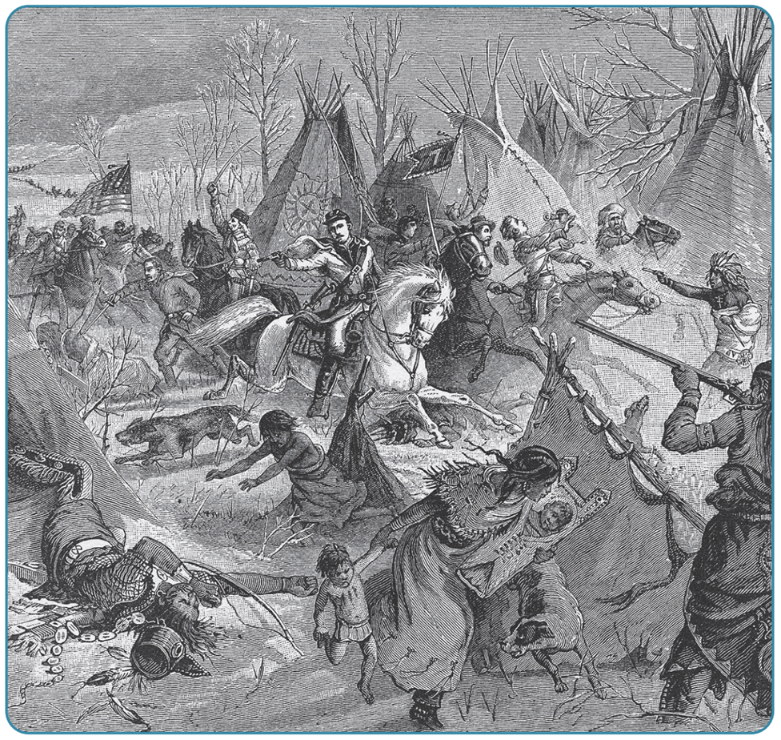
Strand Three: The History of Europe and the Wider World
Chapter Twenty-Six: The Holocaust
Diagram taken from Artefact, 2nd Edition by Eimear Jenkinson and Gregg O'Neill (educate.ie)
@MsDoorley

Slide 10
The Armenian Genocide
In 1915, there were two million Armenians living within the multicultural but declining Ottoman Empire. These Armenians were mostly Christian. The Ottoman Empire lost all of its European territory in the Balkan Wars of 1912-1913, creating instability amongst nationalist groups.
During World War I, the Turkish government attempted to unify all the Turkish people by creating a new empire with one language and one religion. The Armenian people did not belong to the idea of the Turkish Empire. Turkish military leaders accused the Armenians of being traitors, claiming they were siding with their fellow Christians: Russia, the enemy.
From 1915 to 1923, an estimated 1.5 million ethnic Armenians, Assyrians and Greeks were murdered. The Turks used a combination of massacres, forced deportation, death marches into the Syrian Desert, disease and brutality in the concentration camps. The Turks also demolished all traces of Armenian cultural heritage, including masterpieces of architecture and remarkable libraries/archives.
Today, numerous organisations and nations (including Ireland) recognise this event as the ‘Armenian Genocide’. It is considered the first genocide of the twentieth century. However, it has not yet been acknowledged as such by the Turkish government.
When there are any form of genocide, ethnic cleansing or mass massacre we see a pattern that goes with it.
Where else have you seen a pattern where a group of people have been blamed or outed as the root of the problems in a country or society?
Strand Three: The History of Europe and the Wider World
Chapter Twenty-Six: The Holocaust
@MsDoorley

Slide 11
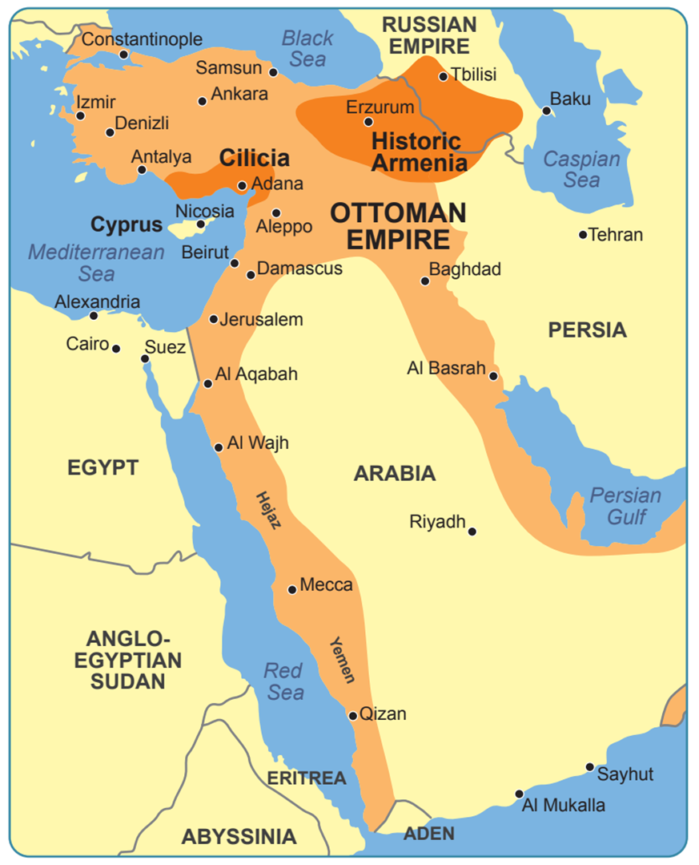
Strand Three: The History of Europe and the Wider World
Chapter Twenty-Six: The Holocaust
Diagram taken from Artefact, 2nd Edition by Eimear Jenkinson and Gregg O'Neill (educate.ie)
@MsDoorley

Slide 12
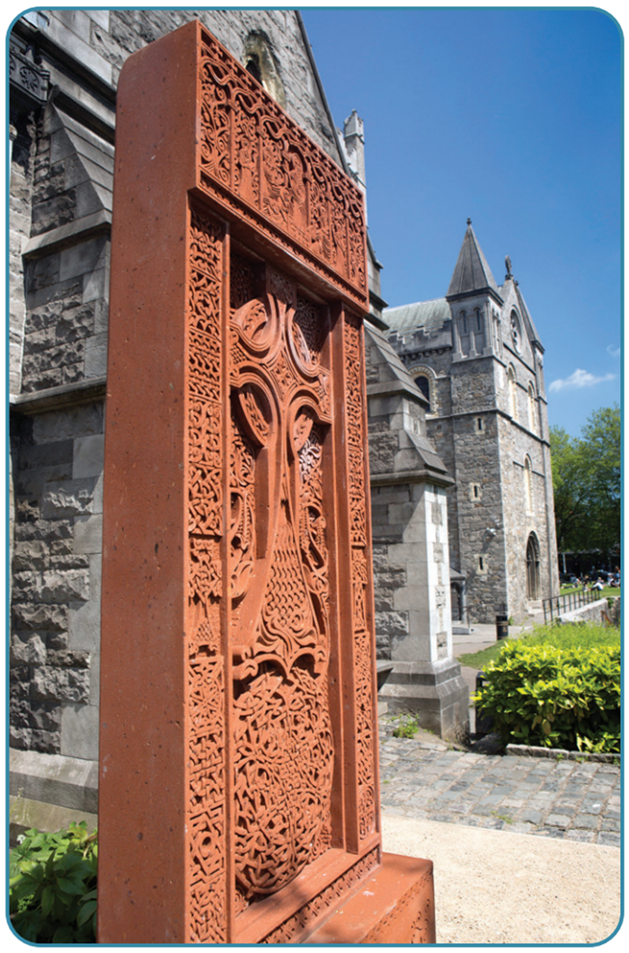
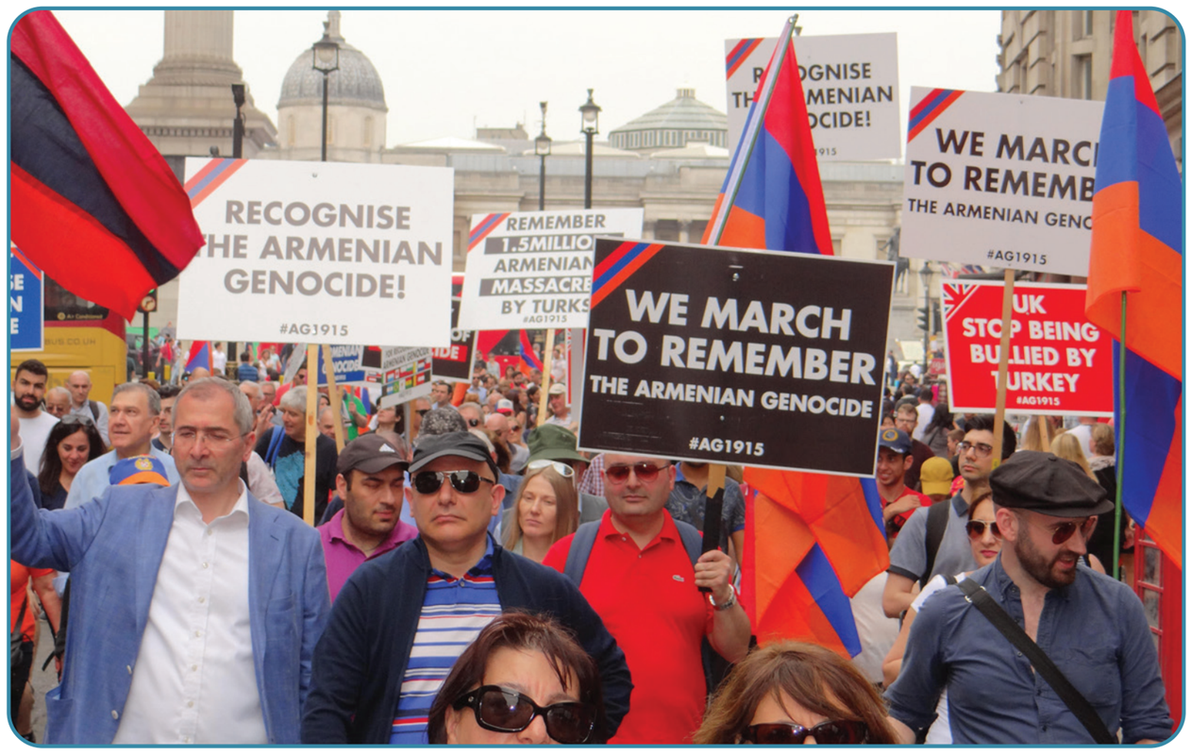
Strand Three: The History of Europe and the Wider World
Chapter Twenty-Six: The Holocaust
Diagram taken from Artefact, 2nd Edition by Eimear Jenkinson and Gregg O'Neill (educate.ie)
@MsDoorley

Slide 13
Checkpoint pg. 346 (Artefact, 2nd Edition)
  Explain the terms genocide and dehumanisation.
  How were so many Native Americans killed in the nineteenth century?
  Why were the Armenians targeted by the Turkish state?
  How were they slaughtered?
Strand Three: The History of Europe and the Wider World
Chapter Twenty-Six: The Holocaust
@MsDoorley

Slide 14
Checkpoint pg. 346 (Artefact, 2nd Edition)
  Genocide: the attempt to eliminate entire peoples or religious or ethnic groups; Dehumanisation: treating people as though they were somehow less than human.
  Unfamiliar European diseases such as measles, whooping cough and influenza; malnutrition resulting from tribes being driven from their land and traditional food sources; during the Gold Rush villages were ambushed and their people slaughtered; several wars broke out between tribes and settlers.
  The Armenians were targeted by the Turks because the government was trying to unify all the Turkish people in a new state with one religion and one language. Armenians were Christian and didn’t belong within the new concept of a Turkish state. They were accused of siding with Turkey’s enemy, fellow Christian state Russia, and called traitors.
  The Armenians were slaughtered in a combination of massacres, forced deportations, death marches into the Syrian desert and also by disease or brutality in concentration camps.
Strand Three: The History of Europe and the Wider World
Chapter Twenty-Six: The Holocaust
@MsDoorley

Slide 15
1939-1945
Chapter 26
26.2: THE HOLOCAUST
26.2: the holocaust
Strand Three: The History of Europe and the Wider World
@MsDoorley

Slide 16
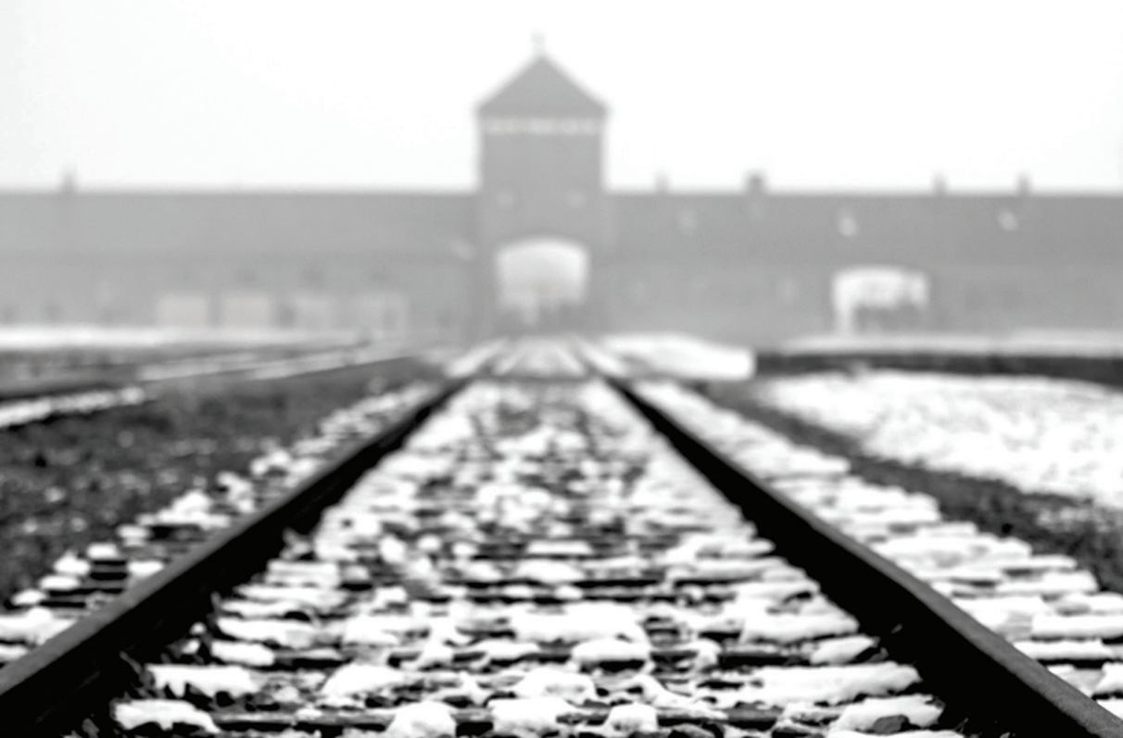
Strand Three: The History of Europe and the Wider World
Chapter Twenty-Six: The Holocaust
Diagram taken from Artefact, 2nd Edition by Eimear Jenkinson and Gregg O'Neill (educate.ie)
@MsDoorley

Slide 17
Anti-Semitism
The Holocaust (Shoah in Hebrew, meaning “catastrophe”) is one of the most significant atrocities in history. The first clear examples of anti-Jewish sentiment can be traced to the 3rd century BCE to Alexandria, Egypt and Ancient Greece. This became the norm throughout Europe during First Crusades (1096–1099). Centuries of anti-Semitism were heightened by Nazi beliefs about their own racial purity and the supposed inferiority of the Jewish people. As we covered in Life In Fascist Germany, Hitler publicly declared the Jews a threat to Germany in Mein Kampf.
As Hitler and the Nazi Party rose to power, Jews came under increasing threat. The Nuremberg Laws (1935) removed the rights from Jews, including their right to vote, own property, hold certain jobs, and to marry non-Jewish citizens. Nazis believed that Germans and other Nordic people were the master race (Aryans). Jews were made to wear the Star of David to mark them out as Jews.
The Night of the Broken Glass (Kristallnacht) resulted in the destruction of Jewish property and 100 Jews were killed. Others were sent to concentration camps or fled the country (Albert Einstein). Following Kristallnacht in 1938, Jews were segregated from the general community and persecuted. Ultimately, the Nazis aimed to exterminated over eight million Jews living in Nazi-occupied Europe.
Strand Three: The History of Europe and the Wider World
Chapter Twenty-Six: The Holocaust
@MsDoorley

Slide 18
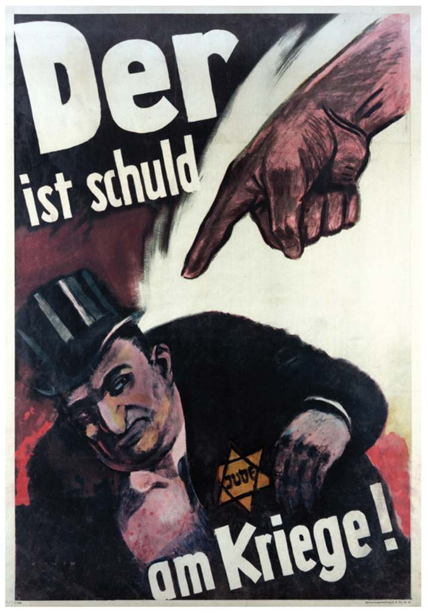
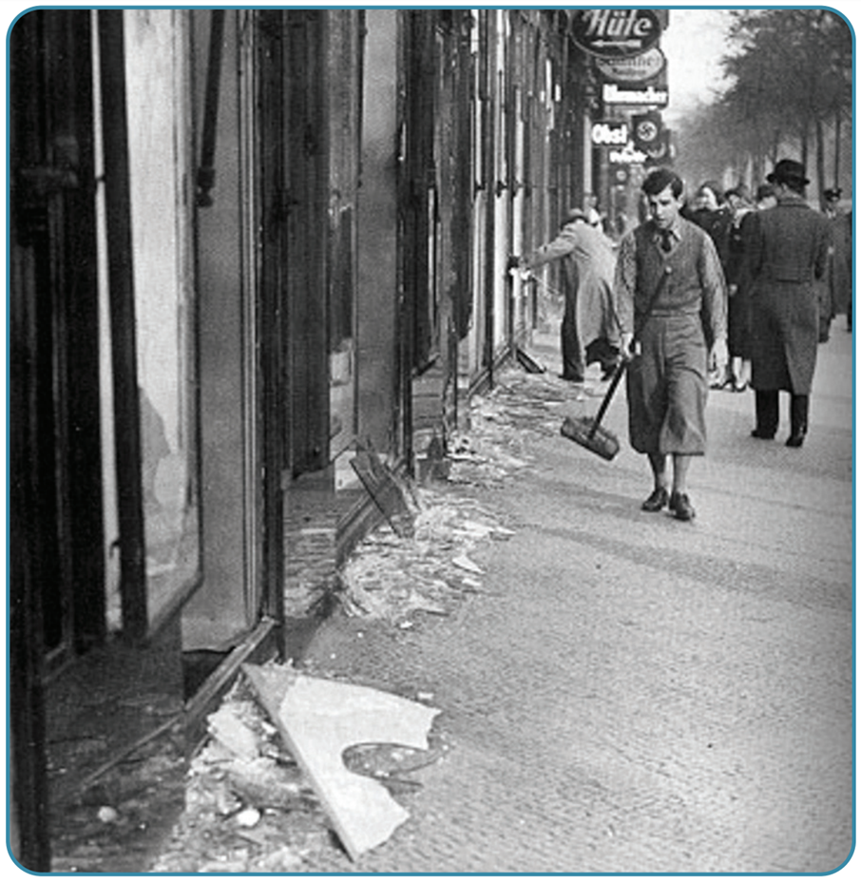
Strand Three: The History of Europe and the Wider World
Chapter Twenty-Six: The Holocaust
Diagram taken from Artefact, 2nd Edition by Eimear Jenkinson and Gregg O'Neill (educate.ie)
@MsDoorley

Slide 19
Jewish Ghettos
After the outbreak of World War II, life became even harder for the Jews. More than 400 ghettos were set up to isolate Jews from the non-Jewish population. A ghetto is a part of a city where a minority group lives, due to social, legal or economic pressure. When Jewish people were transferred to the ghetto, their homes and belongings were taken over.
The ghettos were closed off by high walls and barbed wired fences while the gates were guarded. Food and fuel shortages led to a high morality rate, along with overcrowding and unsanitary conditions led to many outbreaks of diseases.
The first ghetto was set up in Lodz, Poland on 8th February 1940. Approximately, 155,000 Jews (1/3 of the of the city’s total population) were forced to relocate there and made to work in the factories. However, the ghettos were only a temporary solution. They served as round-up centres – made it easier to control the Jewish population and later put them on trains for “resettlement”.
Strand Three: The History of Europe and the Wider World
Chapter Twenty-Six: The Holocaust
@MsDoorley

Slide 20
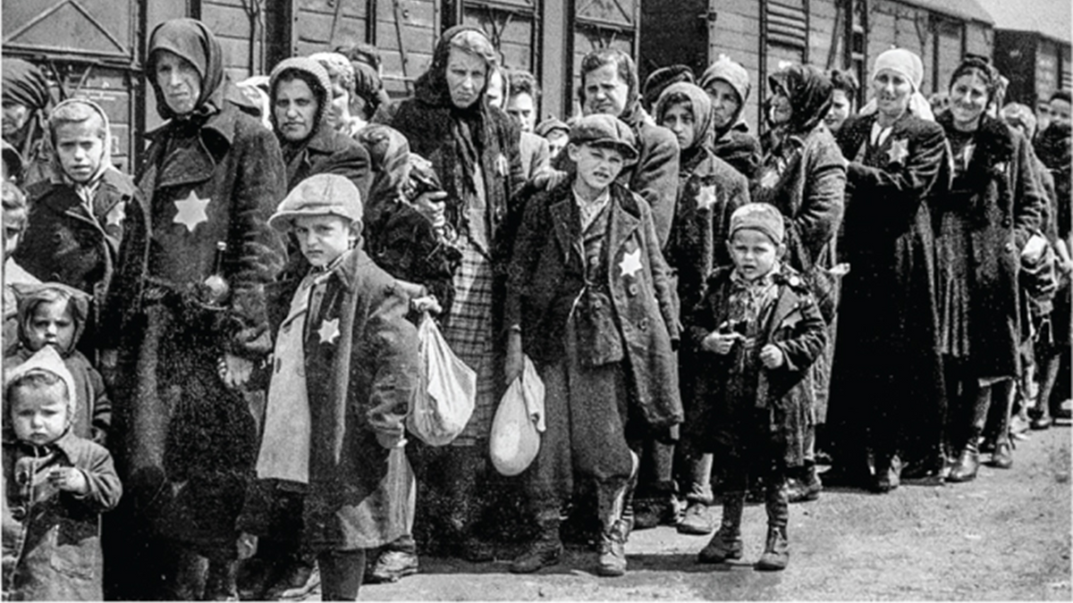
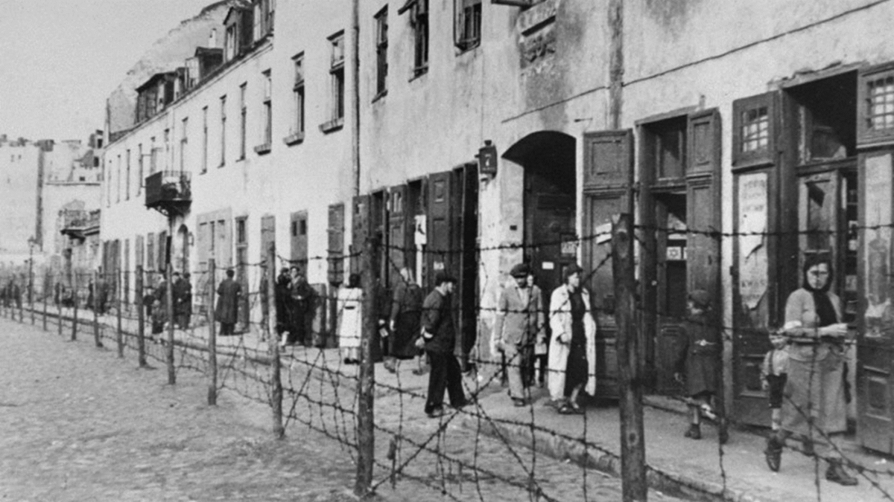
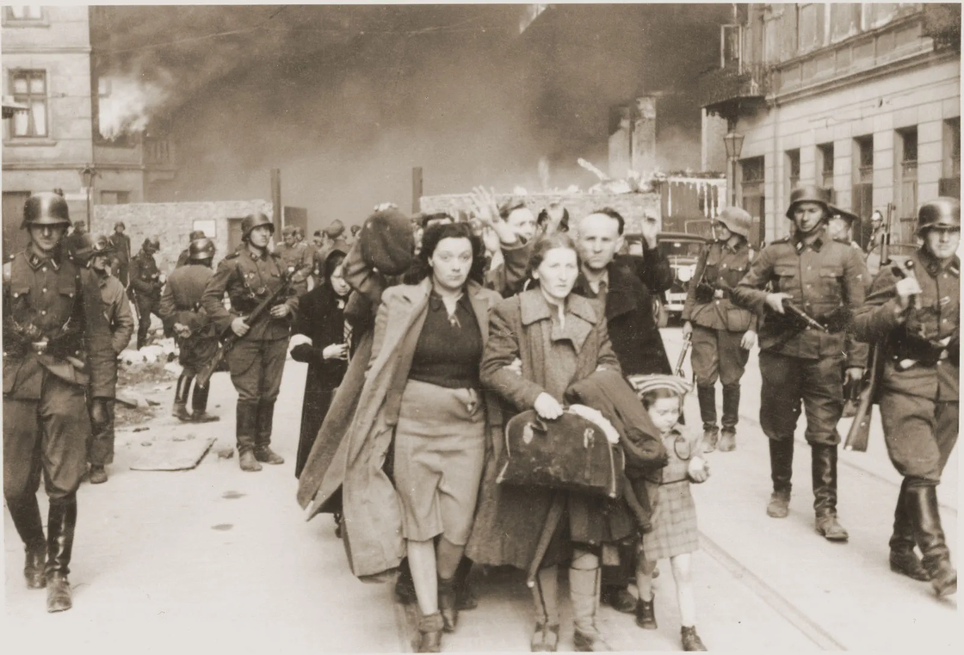
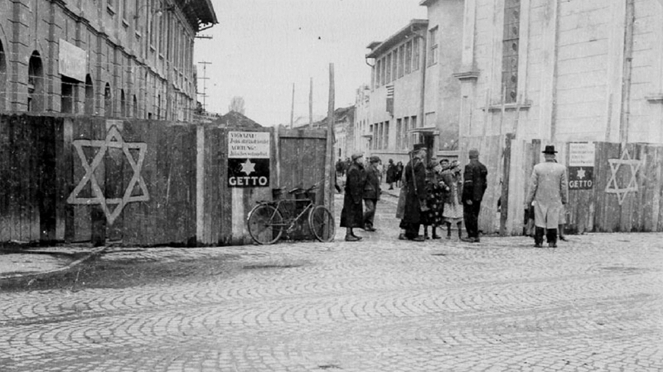
Strand Three: The History of Europe and the Wider World
Chapter Twenty-Six: The Holocaust
Diagram taken from Artefact, 2nd Edition by Eimear Jenkinson and Gregg O'Neill (educate.ie)
@MsDoorley

Slide 21
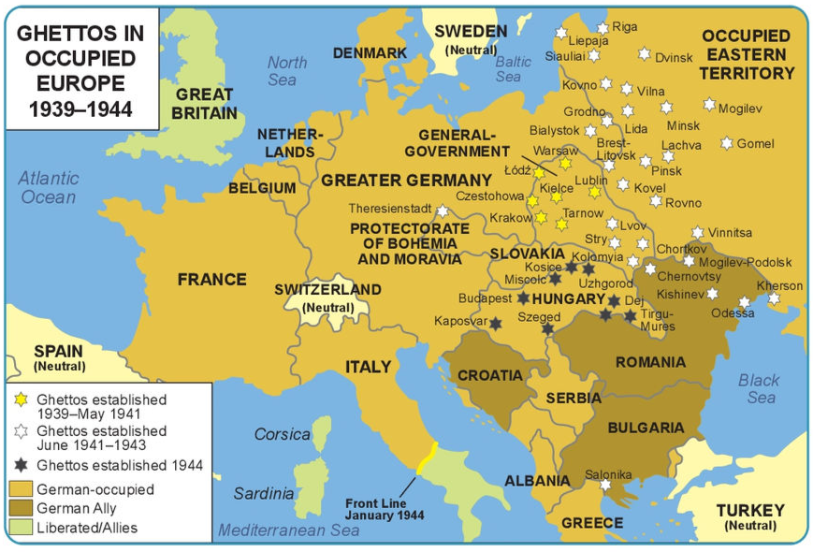
Strand Three: The History of Europe and the Wider World
Chapter Twenty-Six: The Holocaust
Diagram taken from Artefact, 2nd Edition by Eimear Jenkinson and Gregg O'Neill (educate.ie)
@MsDoorley

Slide 22
The Einsatzgruppen and the Final Solution
From 1941, as the German army advanced eastward, it was followed by the Einsatzgruppen. This group were special mobile killing squads that executed ‘anti-German elements’ in the occupied territories. They killed Jews, local resistance fighters, government officials and others. Mass executions took place in forests or other isolated areas. Senior officers noted that this method (a) badly affected their soldier’s mental health and (b) was not efficient enough.
In 1942, the Nazis formulated their official plan to exterminate the Jewish population of Europe. This was called “The Final Solution”. It was agreed at a conference lasting less than two hours in the Wannsee suburb of Berlin on 20th January 1942. Fifteen senior Nazi and German government members were present. Heinrich Himmler was placed in charge of this secret policy. Approximately 11 million Jews lived in wider Europe at the time. The Nazis began to empty the ghettos by deporting the Jewish population to concentration camps. Over 450,000 Jews once lived in the Warsaw ghetto. By the summer of 1943, it is estimated that 395,000 had either died or had been deported to the camps.
Strand Three: The History of Europe and the Wider World
Chapter Twenty-Six: The Holocaust
@MsDoorley

Slide 23
Checkpoint pg. 315 (Artefact, 2nd Edition)
  Explain the terms; Holocaust and ghetto.
  How did the Nazis target the Jewish people before World War II?
  How many Jews lived in Nazi-occupied Europe?
  Describe what happened on Kristallnacht.
  What were the Einsatzgruppen?
  What was decided at the Wannsee Conference?
Strand Three: The History of Europe and the Wider World
Chapter Twenty-Six: The Holocaust
@MsDoorley

Slide 24
Checkpoint pg. 315 (Artefact, 2nd Edition)
1. Holocaust: the genocide of European Jews and others during World War II; Ghetto: a part of a city where a minority group lives, due to social, legal or economic pressure.
2. They were laws passed in 1935 which were made ‘for the protection of German blood and honour’. These laws removed the rights of Jews: to be German citizens; to vote; to own property; to hold certain jobs (such as teachers, civil servants, soldiers and doctors); and to marry non-Jewish citizens.
3. Over eight million Jews lived in Nazi-occupied Europe.
4. Thousands of Jewish-owned buildings, including businesses, synagogues and cemeteries, were destroyed and at least 100 Jews were killed. Thousands more were sent to concentration camps and their homes and belongings were confiscated.
5. Einsatzgruppen: special mobile killing squads that executed ‘anti-German elements’ (Jews, local resistance fighters, government officials and others) in German-occupied territories.
6. The Wannsee Conference is where the method of ‘the Final Solution’ was decided in January 1942.
Strand Three: The History of Europe and the Wider World
Chapter Twenty-Six: The Holocaust
@MsDoorley

Slide 25
Concentration Camps
Concentration camps had been in use by the Nazis since 1933; at first they were forced labour camps. The first was Dachau in Germany. Germany, Poland, Austria, Latvia, the USSR, France, Czechoslovakia and the Netherlands all contained concentration camps. From 1942, special extermination camps were built – all outside Germany. Among these were Auschwitz-Birkenau, Majdanek, Chelmno and Treblinka. There were 28 main concentration camps in total; 22 labour camps and 6 extermination camps. Auschwitz-Birkenau in Poland would become the largest of the extermination camps, consisting of 40 sub-camps.
Strand Three: The History of Europe and the Wider World
Chapter Twenty-Six: The Holocaust
@MsDoorley

Slide 26
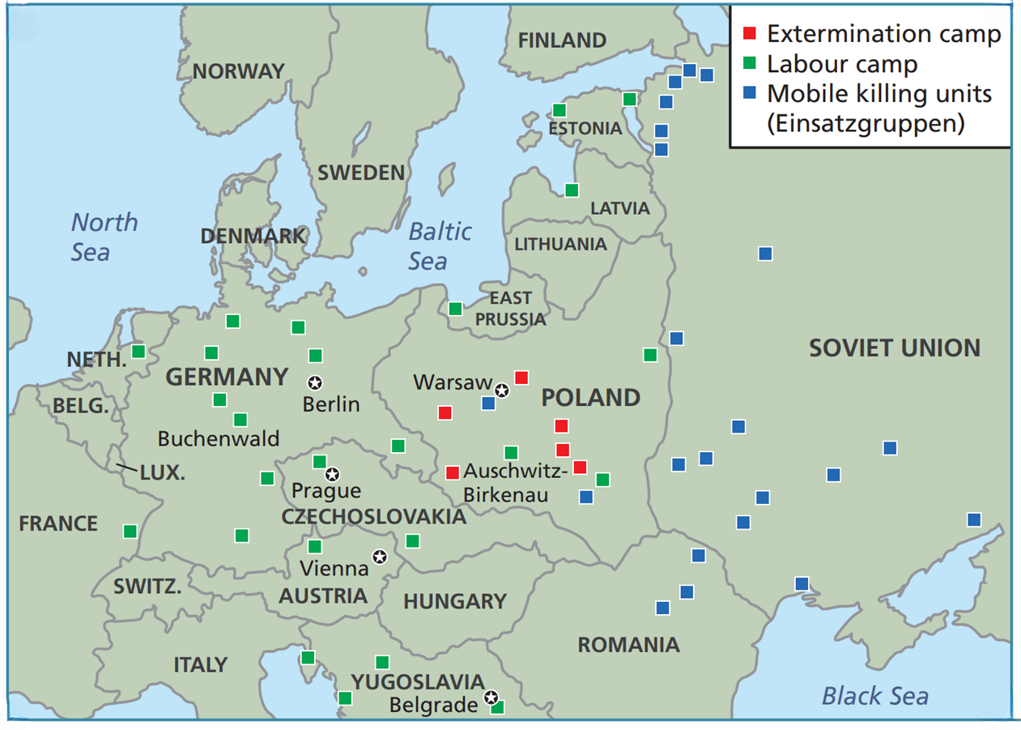
•Arbeitsdorf
•Auschwitz-Birkenau
•Bergen-Belsen
•Belzec
•Buchenwald
•Chelmno
•Dachau
•Flossenburg
•Gross-Rosen
•Herzogenbusch
•Hinzert
•Kaiserwald
•Kauen
•Kraków-Plaszów
•Majdanek
•Mauthausen
•Mittlebau-Dora
•Natzweiler-Struthof
•Neuengamme
•Nidederhagen
•Ravensbruck
•Sachsenhausen
•Sobibor
•Stutthof
•Treblinka
•Vaivara
•Warsaw
Strand Three: The History of Europe and the Wider World
Chapter Twenty-Six: The Holocaust
Diagram taken from Artefact, 2nd Edition by Eimear Jenkinson and Gregg O'Neill (educate.ie)
@MsDoorley

Slide 27
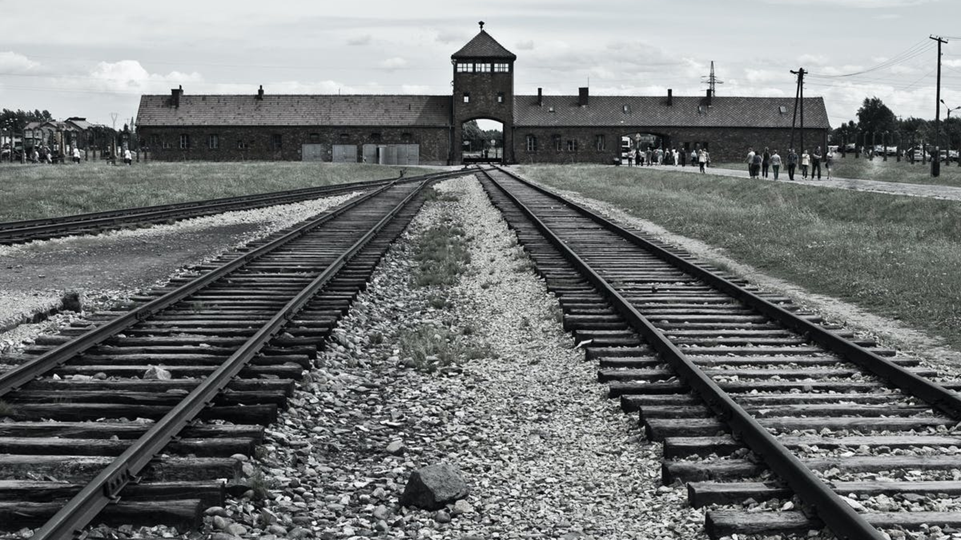
Strand Three: The History of Europe and the Wider World
Chapter Twenty-Six: The Holocaust
Diagram taken from Artefact, 2nd Edition by Eimear Jenkinson and Gregg O'Neill (educate.ie)
@MsDoorley

Slide 28
Life and Death in the Concentration Camps
Jews from all Nazi-occupied Europe were transported to the camps on trains where they would be told to work. Several camps had signs reading “Arbeit macht frei” (work makes one free). Anyone who arrived unwell or unable to work were separated from the rest and killed immediately.
Women, men and children were separated. The camps were set up to remove a person’s identity – both to diminish fighting spirit amongst the prisoners and to allow soldiers to not think of them as human. Prisoners’ heads were shaved and a number was tattooed on their forearm. They were herded into crowded barracks. Many able-bodied Jews worked until they died of disease, starved or were murdered while others died due to the harsh conditions and living conditions.
Some prisoners – especially twins – were used for medical experiments without their consent. An SS physician named Josef Mengele carried out such experiments in Auschwitz.
In the six extermination camps, some prisoners were shot but the majority were killed in large fake shower units which were actually gas chambers. Zyklon B (a cyanide poison) or carbon monoxide gases were used. Any gold fillings in their teeth was extracted and their bodies were cremated by other prisoners. The Nazis had first used the gas years earlier to kill thousand of Germans with physical or intellectual disabilities.
As the tide of the war started to turn in favour of the Allies, the deportation to the camps, executions and gassings all accelerated because Hitler wanted to kill as many Jews while he could. While the Allies closed in, the SS destroyed as much evidence as they could and forced prisoners from the camps in death marches. Many died due to starvation or harsh weather while others were executed when they collapsed or fell behind.
Strand Three: The History of Europe and the Wider World
Chapter Twenty-Six: The Holocaust
@MsDoorley

Slide 29
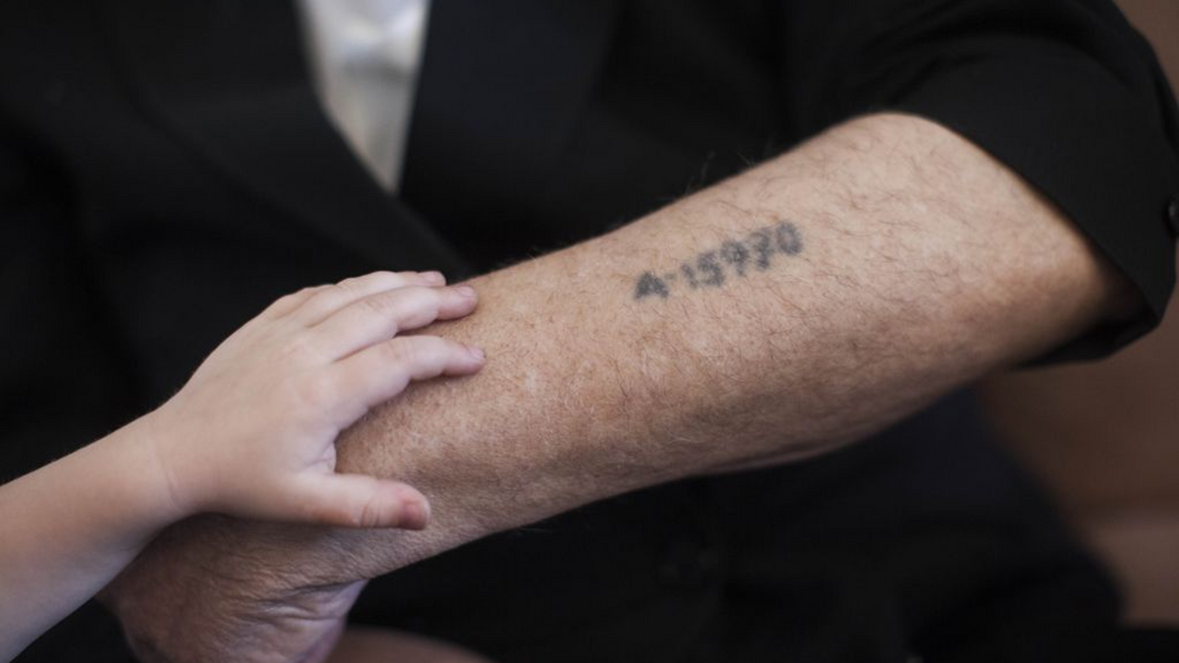
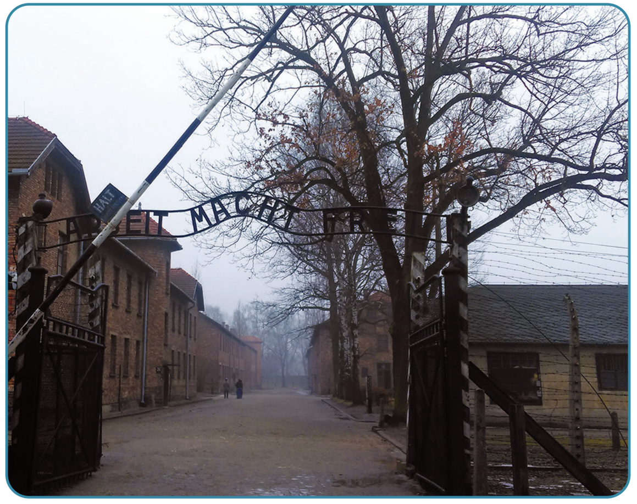
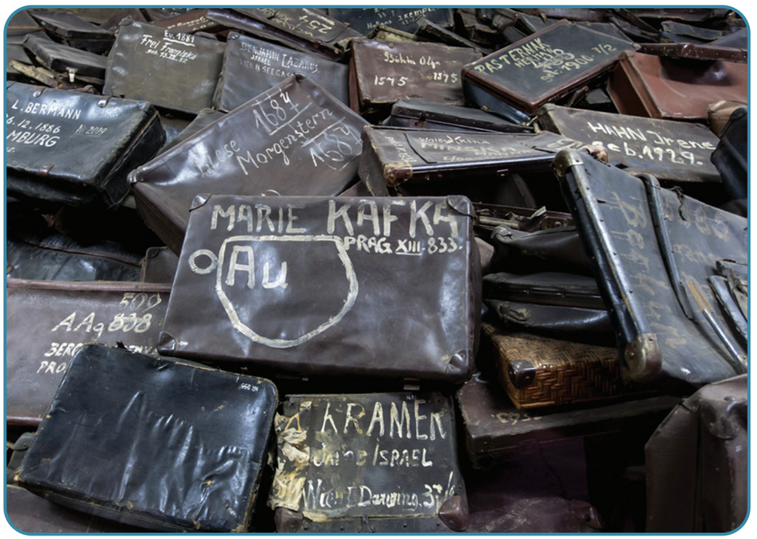
Strand Three: The History of Europe and the Wider World
Chapter Twenty-Six: The Holocaust
Diagram taken from Artefact, 2nd Edition by Eimear Jenkinson and Gregg O'Neill (educate.ie)
@MsDoorley

Slide 30
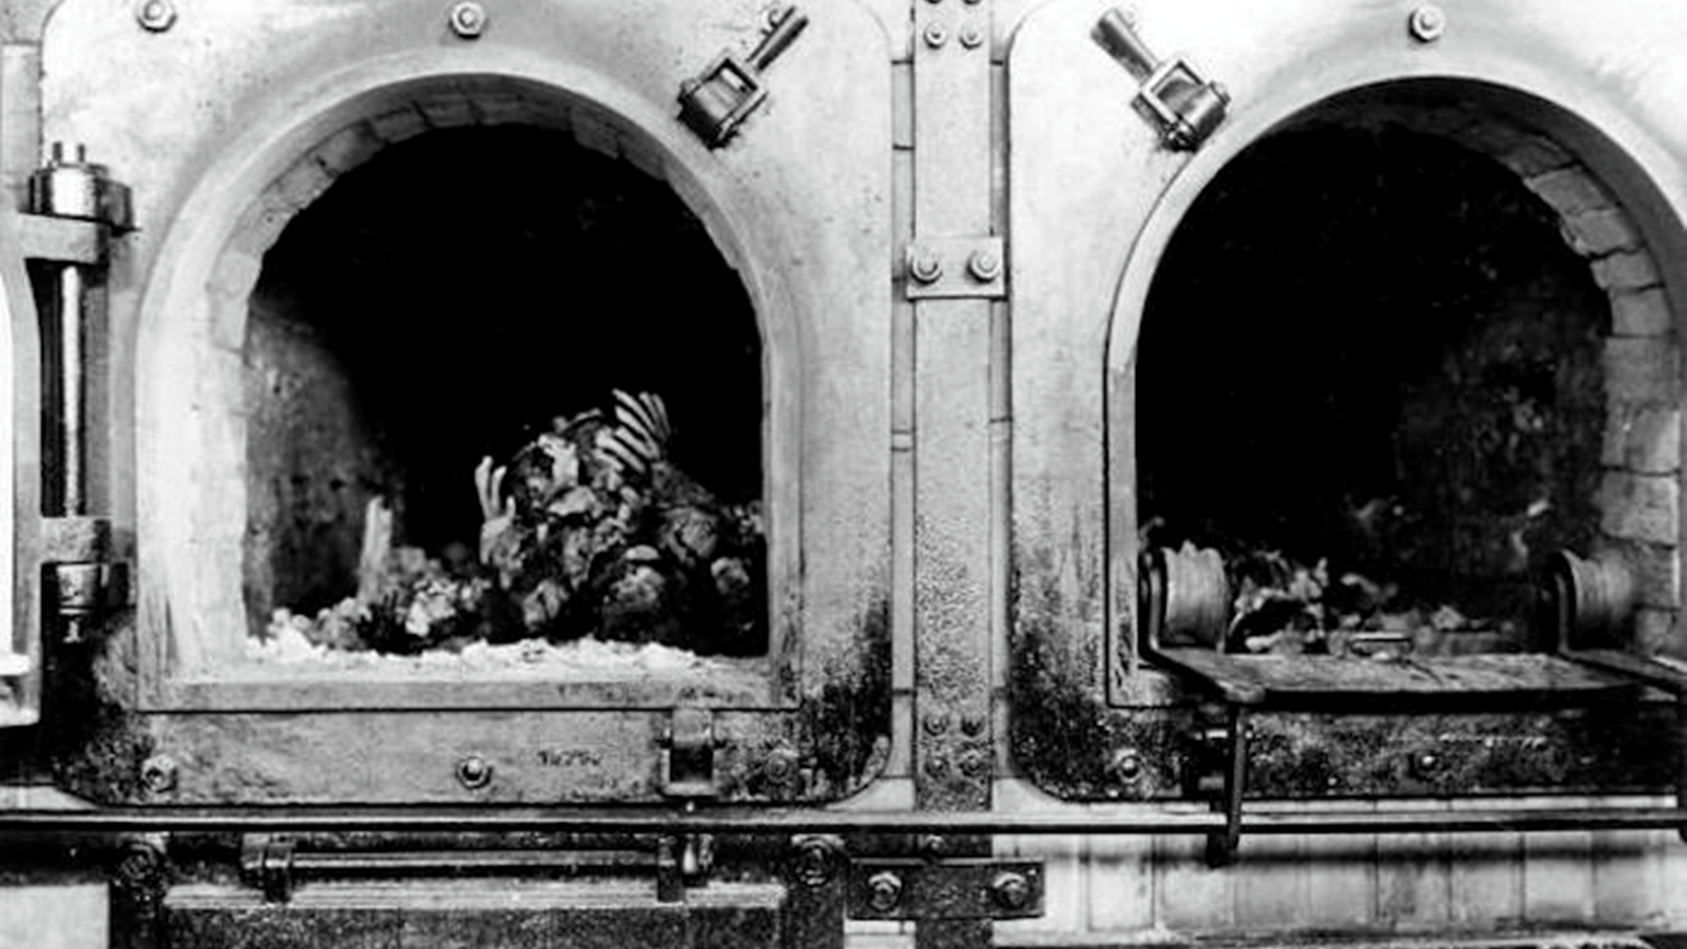
Strand Three: The History of Europe and the Wider World
Chapter Twenty-Six: The Holocaust
@MsDoorley

Slide 31
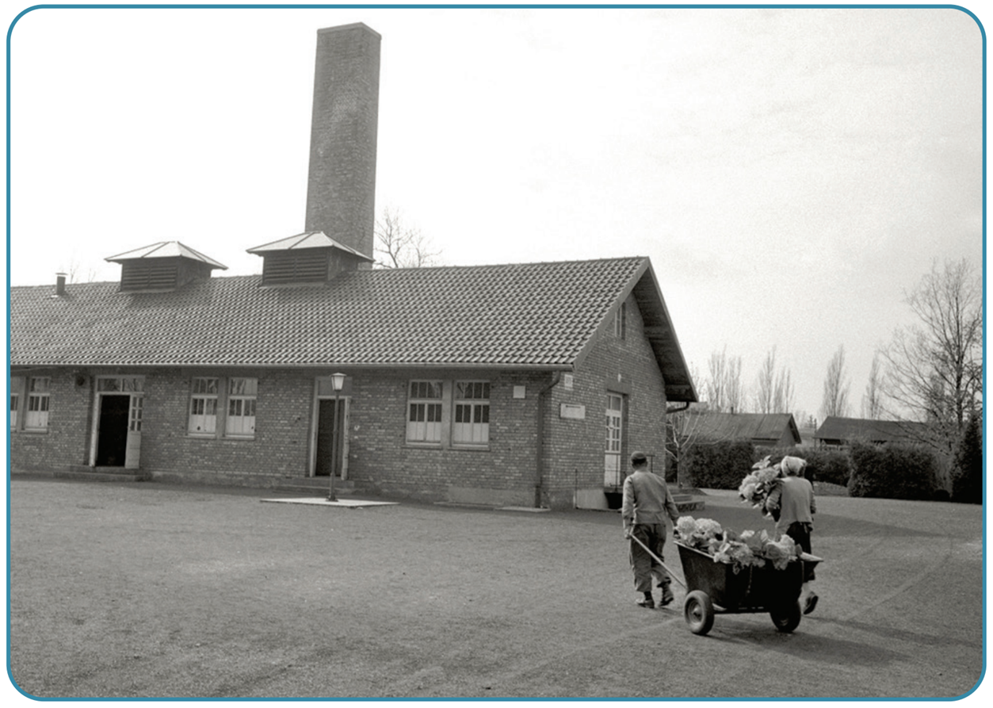
Strand Three: The History of Europe and the Wider World
Chapter Twenty-Six: The Holocaust
Diagram taken from Artefact, 2nd Edition by Eimear Jenkinson and Gregg O'Neill (educate.ie)
@MsDoorley

Slide 32
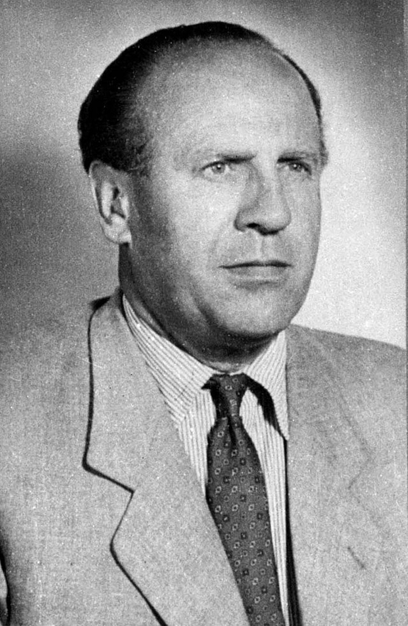
Oskar Schindler, 1908-1974
Oskar Schindler was born in Moravia, Austria-Hungary (now in Czechia). Schindler grew up in the Sudetenland but was ethically German. In 1935 he joined the pro-Nazi Sudeten German Party and in 1939 he joined the Nazi Party. He leased a formerly Jewish-owned enamelware factory in Krakow, Poland. By 1942 nearly half of the workers at the plant were Jewish. Helped by his wife and staff and using his German connections, he sheltered approximately 1,200 Jews from deportation by employing them in his factories, which supplied the German army during World War II. By the end of the war, Schindler had spent his entire fortune on bribes for officials and on supplies for his employees. In 1962 he was named Righteous Among the Nations - an award recognising non-Jews who risked their lives to save Jews during the Holocaust - by Yad Vashem, Israel’s official Holocaust memorial. He died aged 66 and was buried in the Catholic cemetery on Mount Zion in Jerusalem.
Strand Three: The History of Europe and the Wider World
Chapter Twenty-Two: Life in Communist Russia
Diagram taken from Artefact, 2nd Edition by Eimear Jenkinson and Gregg O'Neill (educate.ie)
@MsDoorley

Slide 33
The liberation of the camps
The Soviet soldiers were the first Allies to encounter the camps. Their advance westward was so rapid that the Nazis had no time to dismantle the Madjanek camp in eastern Poland.
The Soviets arrived on 23rd July 1944, finding the camp nearly intact. Crematorium ovens, mass graves and unburied piles of corpses were found in many camps. On 27th January 1945, they entered Auschwitz to find thousands of prisoners dying and sick. Medics tried to save the remaining prisoners but many were too weak to digest food – half of those discovered died days after discovery.
British, Canadian, American and French troops were liberated concentration camps. The Americans liberated Buchenwald and Dachau while the British liberated Bergen-Belsen (only a few weeks after the death of Anne Frank). By May 1945, all concentration camps had been liberated. Reports of these atrocities shocked the world.
Strand Three: The History of Europe and the Wider World
Chapter Twenty-Six: The Holocaust
The 27th January is the International Holocaust Remembrance Day to commemorate the 6 million Jews and the other millions of victims of the Nazi regime and its collaborators.
@MsDoorley

Slide 34
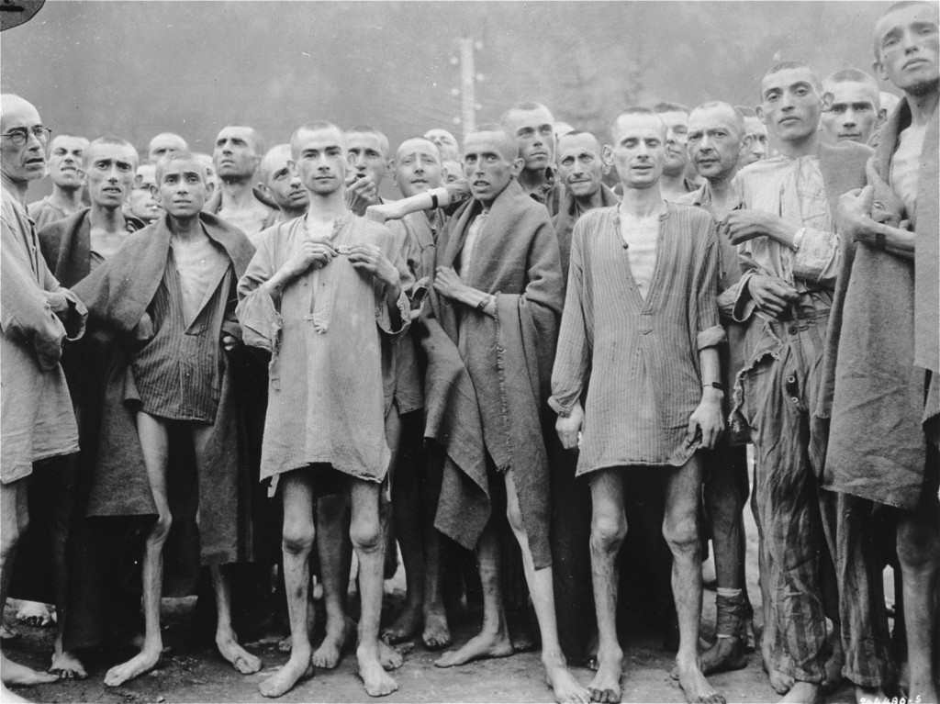
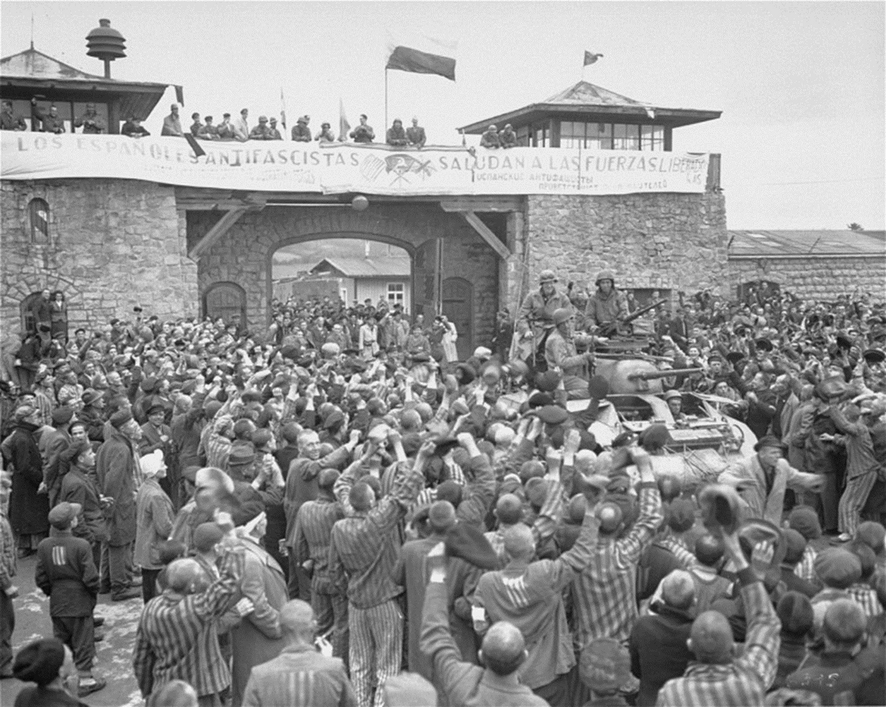
Strand Three: The History of Europe and the Wider World
Chapter Twenty-Six: The Holocaust
Diagram taken from Artefact, 2nd Edition by Eimear Jenkinson and Gregg O'Neill (educate.ie)
@MsDoorley

Slide 35
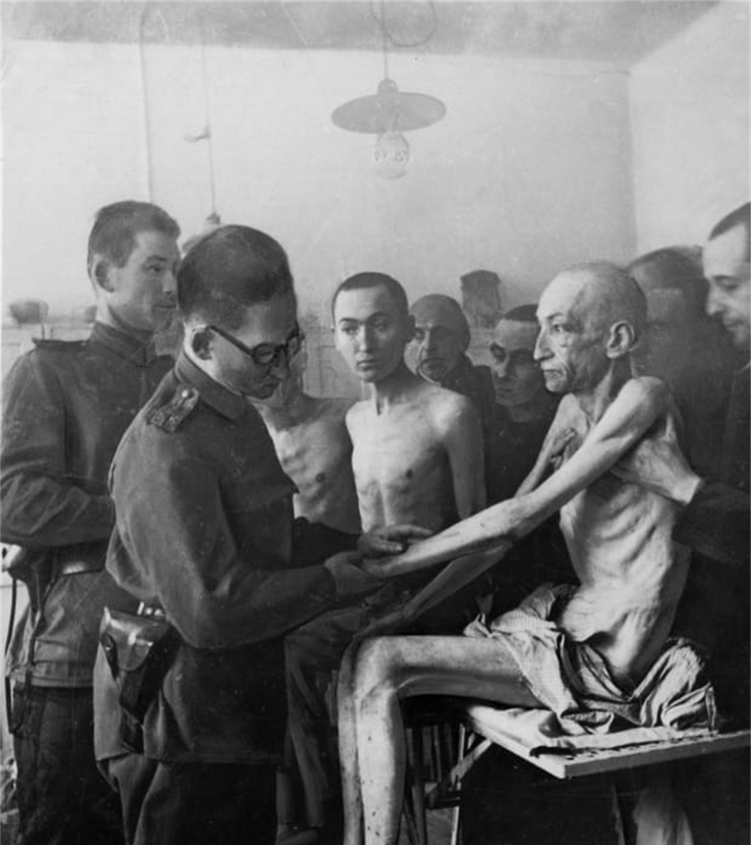
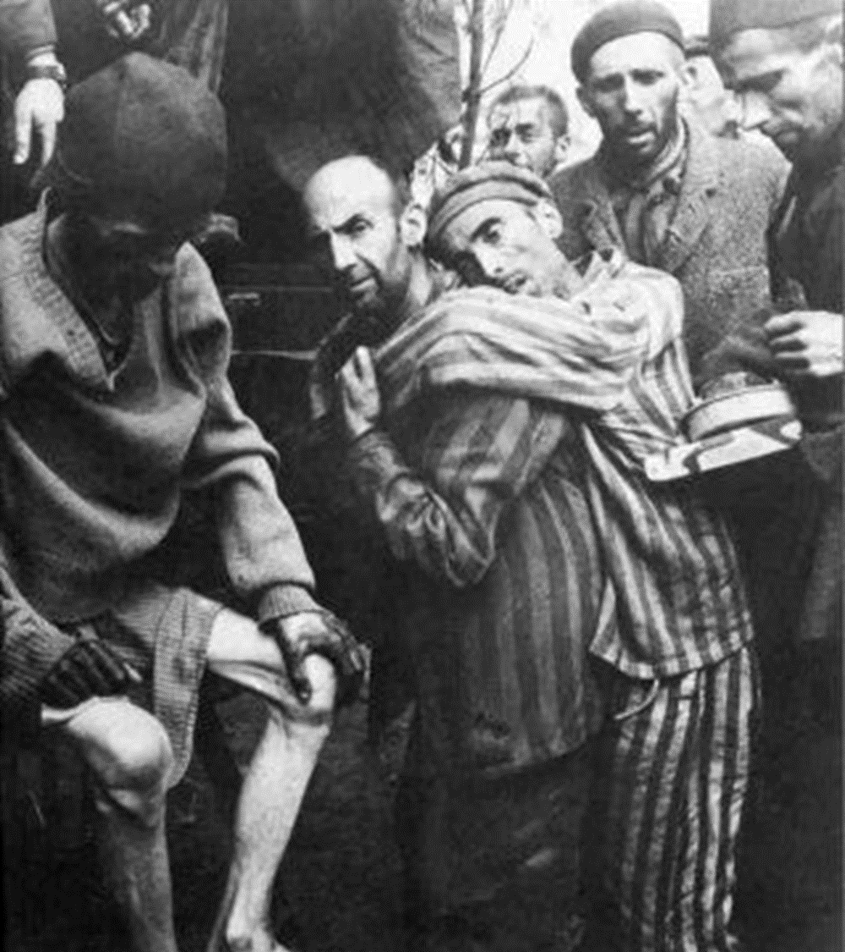
Strand Three: The History of Europe and the Wider World
Chapter Twenty-Six: The Holocaust
Diagram taken from Artefact, 2nd Edition by Eimear Jenkinson and Gregg O'Neill (educate.ie)
@MsDoorley

Slide 36
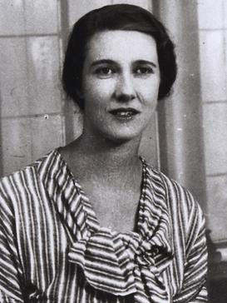
Mary Elmes, 1908-2002
Mary Elmes was born in Cork, Ireland. She studied French and Spanish literature at Trinity College Dublin. In February 1937, Elmes joined the University of London Ambulance Unit and was sent to a children’s hospital in Almeria during the Spanish Civil War. In 1942 Elmes, with help from colleagues, rescued dozens of children from Vichy France, taking them to safe houses or helping them to flee the country. Elmes hid many children in the boot of her car and drove them to safety. She aided others by securing documents that allowed them to escape through the undercover network in Vichy France. Early in 1943, Elmes was arrested on suspicion of aiding the escape of Jews and was imprisoned in Toulouse. She was later moved to the Fresnes Prison run by the Gestapo near Paris, where she spent six months. After World War II, Elmes was awarded the Legion of Honour (then the highest civilian award in France), which she refused to accept because it brought unwanted attention for her actions. In 2013, she was posthumously recognised by Yad Vashem as Righteous Among the Nations. She is the only Irish person to hold the honour, which is given to non-Jews who risked their lives to save Jews during World War II. On the 9th July 2019 Cork City Council named a new pedestrian bridge in honour of Mary Elmes.
Strand Three: The History of Europe and the Wider World
Chapter Twenty-Two: Life in Communist Russia
Diagram taken from Artefact, 2nd Edition by Eimear Jenkinson and Gregg O'Neill (educate.ie)
@MsDoorley

Slide 37
The Aftermath of the Holocaust
It is estimated that six million Jews were murdered in the Holocaust – one million in Auschwitz alone. Millions of others were killed as well including (but not limited to): 2.5 million Soviet prisoners of war; 2 million Poles and 500,000 Roma. Generations were wiped out and many loved ones’ fates would never be known.
Many Jewish survivors of the camps left Europe for good after the war and emigrated. They moved to the US, Canada or South Africa. In 1948, the new Jewish state of Israel was founded in Palestine and today its Jewish population numbers 6.5 million. For many, the sense of a shared Jewish identity became stronger in the wake of the terrible collective trauma and loss that was the Holocaust.
Strand Three: The History of Europe and the Wider World
Chapter Twenty-Six: The Holocaust
Consequences of the Holocaust
The mass murder of six million Jews
The mass murder of Slavic people, Roma, LGBT+ people, prisoners of wars and people with disabilities.
Jewish emigration to the US, Canada, France and South Africa
Strengthening of a shared Jewish identity.
@MsDoorley

Slide 38
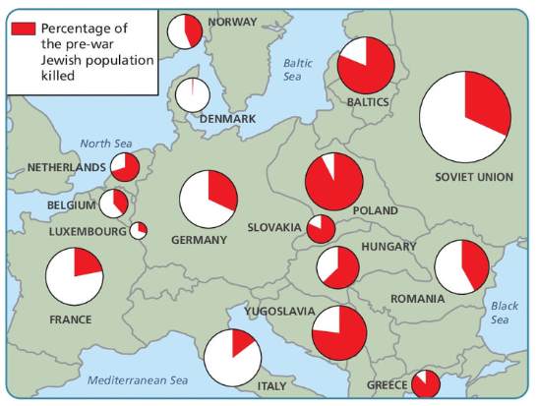
Strand Three: The History of Europe and the Wider World
Chapter Twenty-Six: The Holocaust
Diagram taken from Artefact, 2nd Edition by Eimear Jenkinson and Gregg O'Neill (educate.ie)
@MsDoorley

Slide 39
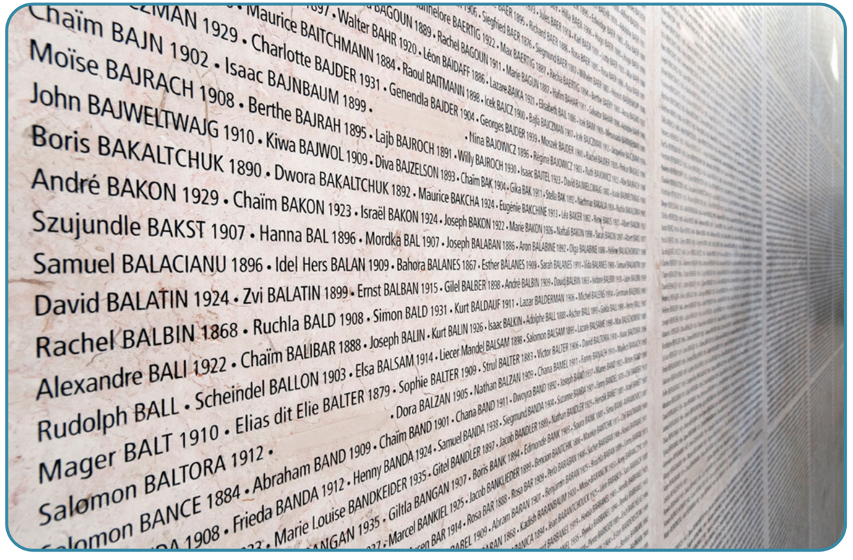
Strand Three: The History of Europe and the Wider World
Chapter Twenty-Six: The Holocaust
Diagram taken from Artefact, 2nd Edition by Eimear Jenkinson and Gregg O'Neill (educate.ie)
@MsDoorley

Slide 40
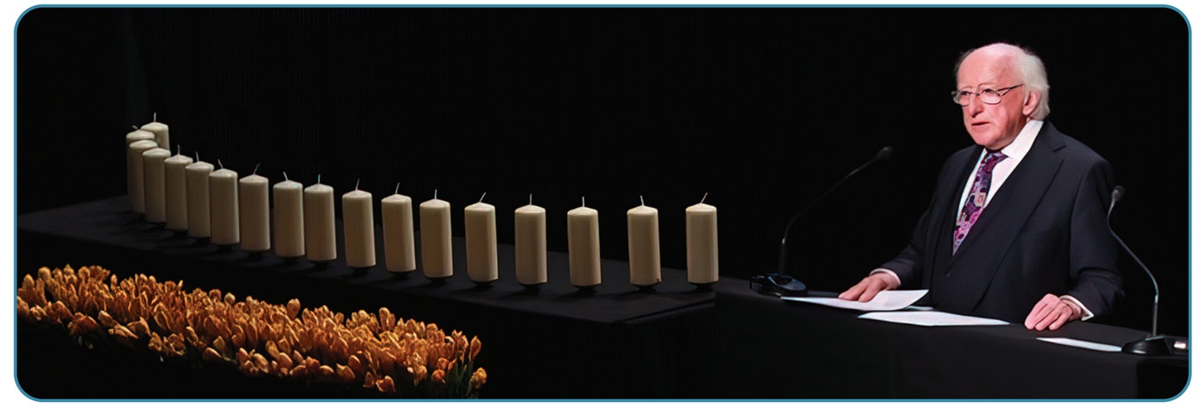
Strand Three: The History of Europe and the Wider World
Chapter Twenty-Six: The Holocaust
Diagram taken from Artefact, 2nd Edition by Eimear Jenkinson and Gregg O'Neill (educate.ie)
@MsDoorley

Slide 41
Checkpoint pg. 354 (Artefact, 2nd Edition)
  What were concentration camps? Name four and the countries where they were located.
  What happened to people in the concentration camps?
  Describe the liberation of the camps.
  What were the results of the Holocaust?
  After World War II, Jewish people strove to establish the state of Israel. Why do you think they did this?
Strand Three: The History of Europe and the Wider World
Chapter Twenty-Six: The Holocaust
@MsDoorley

Slide 42
Checkpoint pg. 354 (Artefact, 2nd Edition)
1. At first, concentration camps were forced labour camps, but from 1942 special extermination camps (death camps) were also constructed. Four examples: Dachau in Germany; Auschwitz-Birkenau in Poland; Majdanek in Poland; Chelmno in Poland; Treblinka in Poland, etc.
2. In concentration camps people were dehumanised. Their belongings were taken from them on arrival and anybody who was unwell or unable to work was killed immediately. Women, men and children were separated. Prisoners’ heads were shaved and each had a number tattooed on their forearm. Some prisoners were used for medical experiments without their consent, etc.
3. Soviet soldiers were the first Allies to encounter concentration camps as they pursued the German forces westwards. They found Majdanek camp in eastern Poland nearly intact on 23 July 1944. Auschwitz was liberated on 27 January 1945. Medics tried to save prisoners, but many were too weak even to digest food. British, Canadian, American and French troops also liberated camps. By May 1945, all 20,000 camps had been liberated.
4. An estimated six million Jews were killed; millions of others were systematically killed, including Poles and other Slavic people, Roma, LGBT people, communists and prisoners of war; generations were wiped out; large-scale emigration by Jewish survivors; a strengthening of a shared Jewish identity.
5. Student’s opinion answer. Students might address the following: Jewish religious belief (see Genesis, Exodus…) is that God promised the land of Israel to the Jewish people. They had experienced persecution in Europe since the Middle Ages, but the Holocaust was such a shattering trauma that the idea of a Jewish state as a permanent, safe homeland became urgent.
Strand Three: The History of Europe and the Wider World
Chapter Twenty-Six: The Holocaust
@MsDoorley

Slide 43
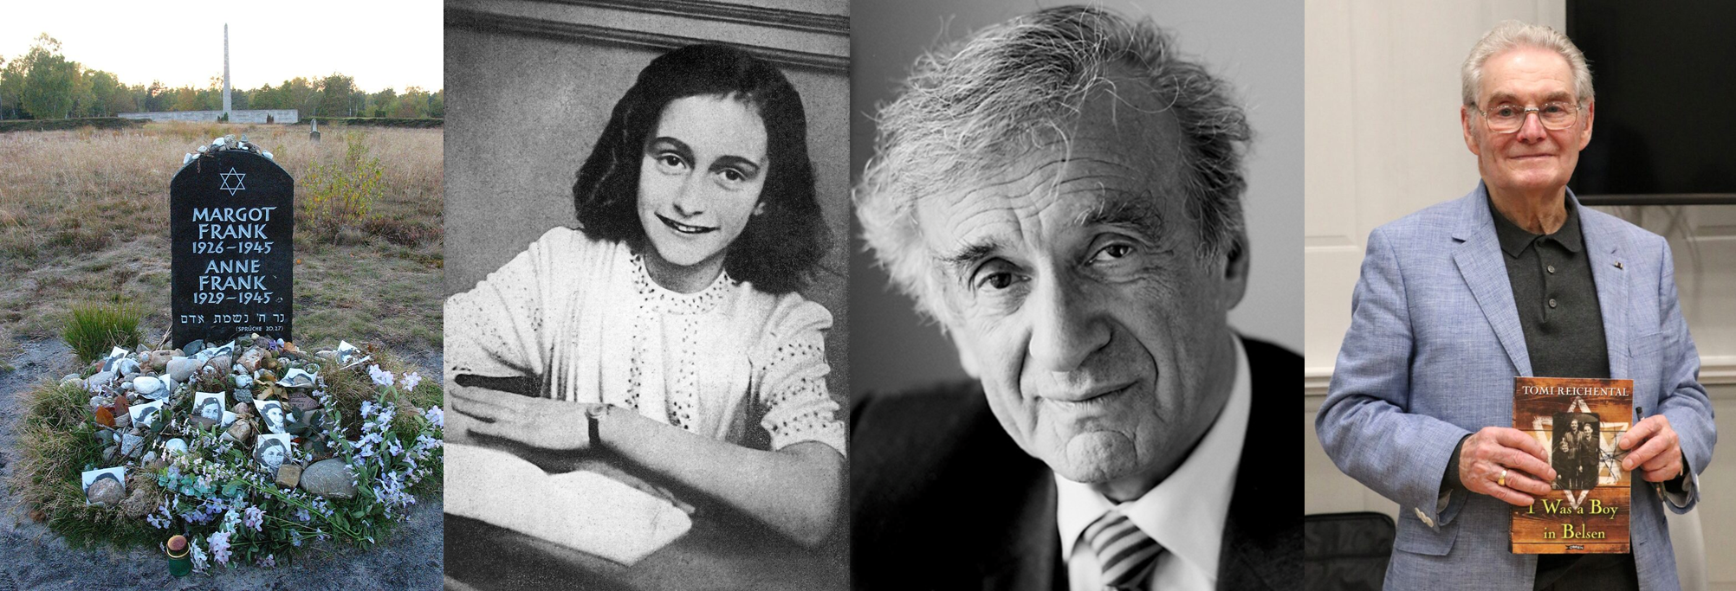
Famous Jews from the Holocaust
•Anne Frank – died in 1945
•Elie Wiesel – died in 2016
•Tomi Reichental – moved in Ireland in 1959
Strand Three: The History of Europe and the Wider World
Chapter Twenty-Six: The Holocaust
@MsDoorley

Slide 44
1939-1945
Chapter 26
26.3: GENOCIDES AFTER THE HOLOCAUST
26.3: genocides after the holocaust
Strand Three: The History of Europe and the Wider World
@MsDoorley

Slide 45
The Crime of Genocide
In the decades since the Holocaust, the world has seen many more acts of genocide, for example in Cambodia and Rwanda. The UN Convention on the Prevention and Punishment of the Crime of Genocide was passed in 1948; however, the international community has repeatedly failed to prevent it.
Presently, there are 42 recognised genocides throughout history, 3 of which are still ongoing. These include:
  The Genocide of Aboriginals in Tasmania (1820s-1832) and Australia (1840-1897)
  Assyrian genocide - Ottoman Empire (1915-1919)
  Holodomor - Ukraine (1932-1933)
  Chetniks' Genocide of Bosniaks and Croats - Yugoslavia (1941-1945)
  Bosnian Genocide - Bosnia and Herzegovina (1992-1995)
  Darfur genocide - Darfur, Sudan (2003-Present)
  Uyghur genocide - Xinjiang, China (2014-Present)
  Rohingya genocide - Rakhine State, Myanmar (2016-Present)
Strand Three: The History of Europe and the Wider World
Chapter Twenty-Six: The Holocaust
@MsDoorley

Slide 46
The Cambodian Genocide
In 1975, the Cambodian government was overthrown by Pol Pot and the Khmer Rogue, followers of the Communist Party of Kampuchea. Their idealised vision of their country was based on the country’s “pure” peasant past. They closed the country to the outside world, forced city dwellers to move to collective farms, outlawed all religions and brutally targeted anyone who was educated or suspected of opposing the new regime. In addition, the Khmer Rogue aimed to eliminate ethnic minorities such as the ethnic Vietnamese, Thai and Chinese people as well as the Muslim Cham people.
Starvation and disease killed great numbers of people at the forced-labour farms. Torture was also widespread. It is claimed that 17,000 people passed through the notorious Tuol Sleng prison and only seven survived. As more and more people were sent to prison, the Khmer Rogue switched to a system of ‘killing fields’ – mass executions at hundreds of sites all across Cambodia. As well as the people mentioned previously, the Khmer Rogue also executed people who could no longer work or make the journey to the camps, the families of anyone deemed ‘undesirable’ and at least 25,000 Buddhist monks.
In the years 1975 to 1979, between 1.7 and 3 million Cambodians died in the Khmer Rogue’s killing fields roughly one-quarter of the population.
Strand Three: The History of Europe and the Wider World
Chapter Twenty-Six: The Holocaust
@MsDoorley

Slide 47
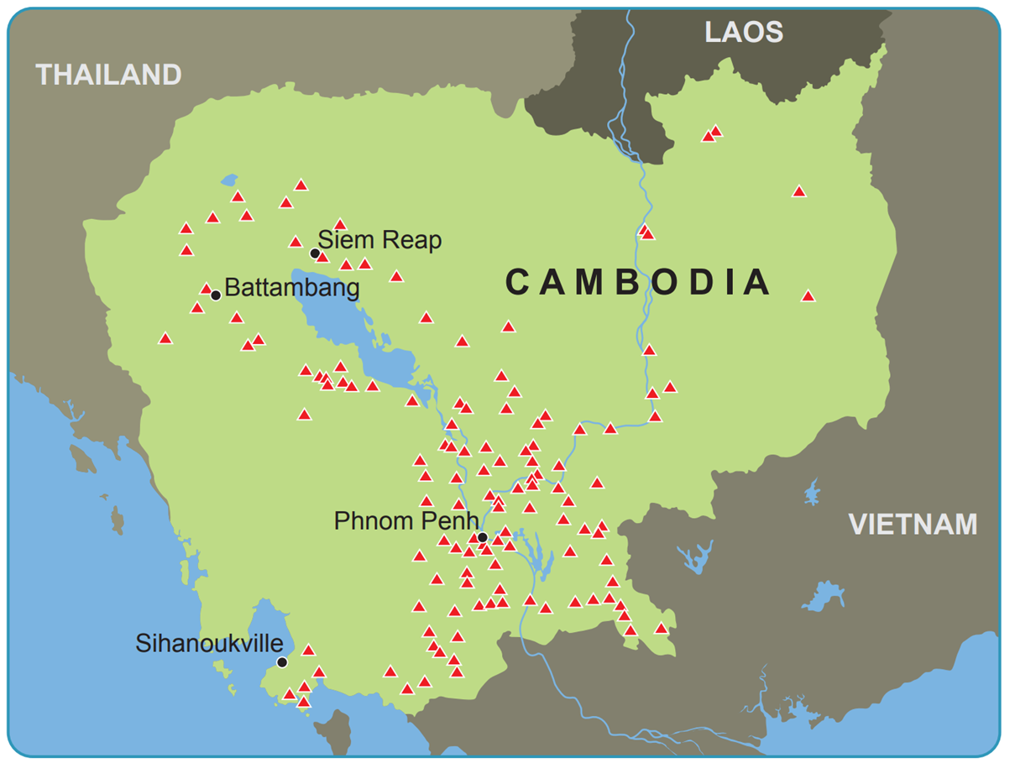
Strand Three: The History of Europe and the Wider World
Chapter Twenty-Six: The Holocaust
Diagram taken from Artefact, 2nd Edition by Eimear Jenkinson and Gregg O'Neill (educate.ie)
@MsDoorley

Slide 48
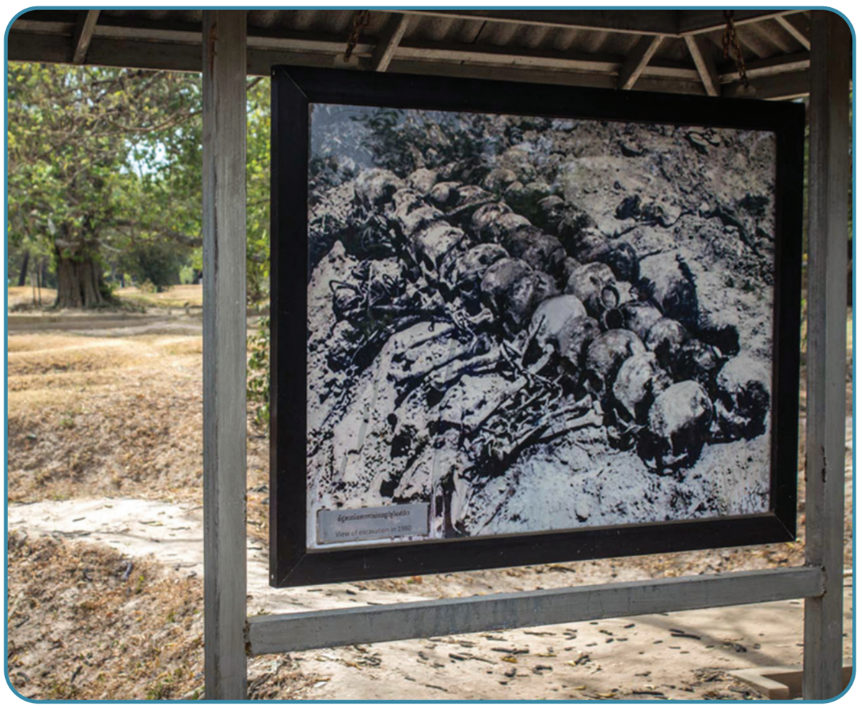
Strand Three: The History of Europe and the Wider World
Chapter Twenty-Six: The Holocaust
Diagram taken from Artefact, 2nd Edition by Eimear Jenkinson and Gregg O'Neill (educate.ie)
@MsDoorley

Slide 49
The Rwanda Genocide
In the 1990s, Rwanda was a small agricultural country with the highest population density in Africa. About 85% of its population was ethnically Hutu; the rest was Tutsi, along with a small number of Twa (the original inhabitants of Rwanda). Tensions between the Hutu and Tutsi had developed over time and had led to civil war. A power-sharing agreement had angered Hutu extremists. Evidence exists of planning, weapons purchase and dehumanising propaganda (especially radio broadcasts) in the early 1990s.
Rwanda President Juvénal Habyarimana, a Hutu, was killed when his plane was shot down on the 6th April 1994. Responsibility for this is still unknown. Hutu extremists began the Rwandan Genocide in the capital city, Kigali, the next day. Among the first victims were the Hutu Prime Minster Agathe Uwilingiyimana and 10 Belgian peacekeepers. Mass killings of Tutsis and moderate Hutus in Kigali quickly spread to the rest of Rwanda. Officials rewarded killers with food, drink, drugs and money.
Strand Three: The History of Europe and the Wider World
Chapter Twenty-Six: The Holocaust
@MsDoorley

Slide 50
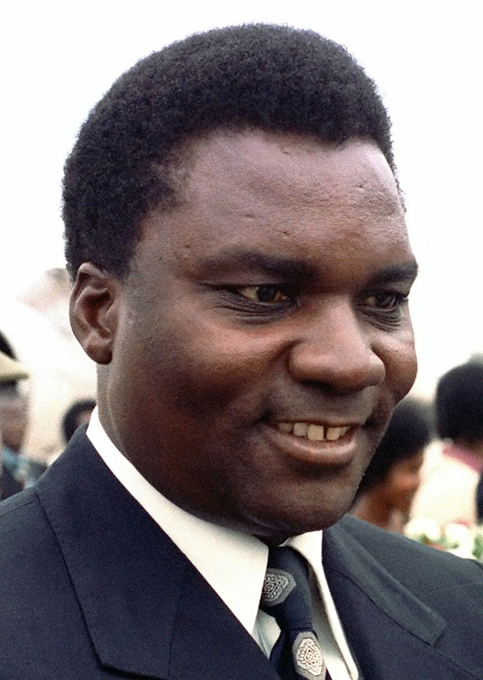
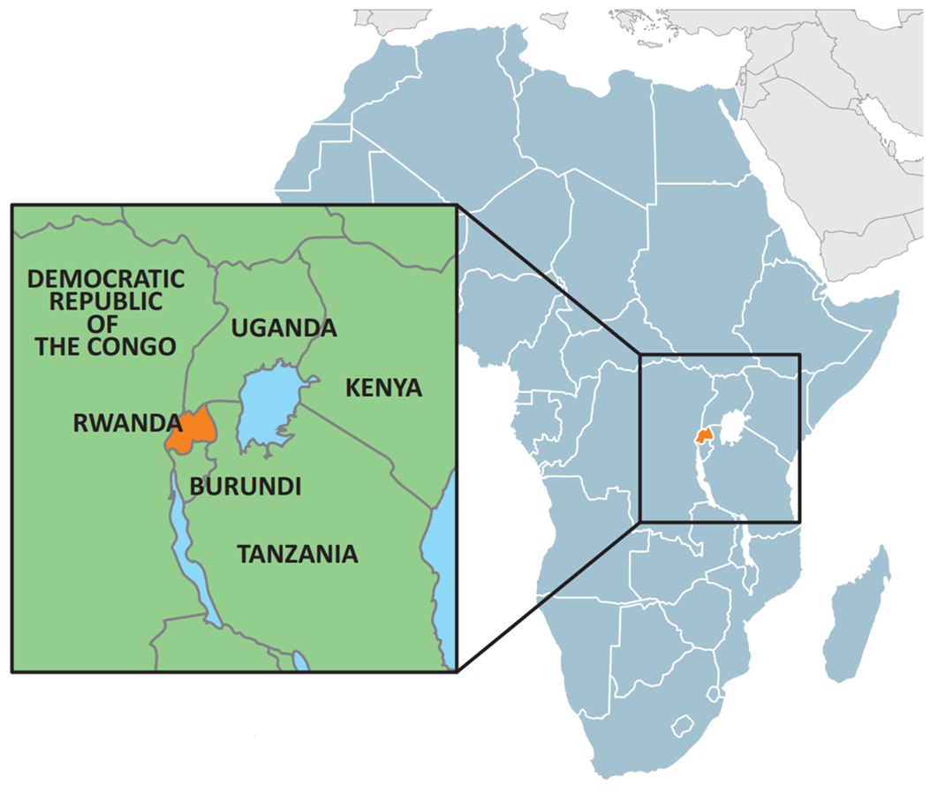
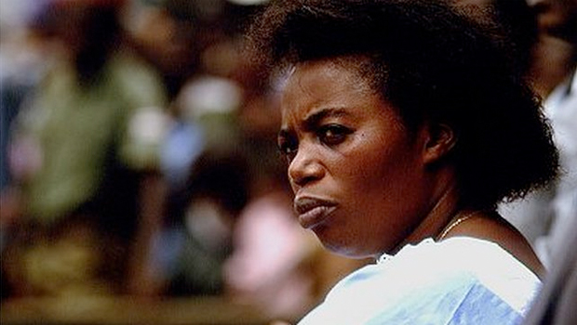
Strand Three: The History of Europe and the Wider World
Chapter Twenty-Six: The Holocaust
Diagram taken from Artefact, 2nd Edition by Eimear Jenkinson and Gregg O'Neill (educate.ie)
@MsDoorley

Slide 51
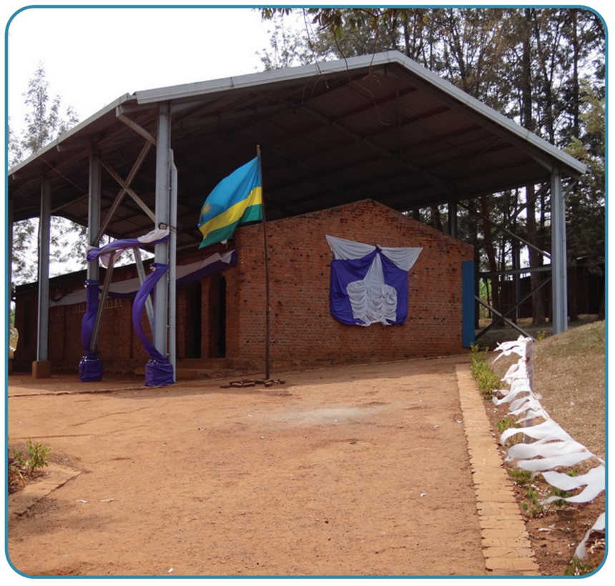
The Rwanda Genocide
By the time the Rwandan Patriotic Front, led by Paul Kagame, gained control through a military offensive in early July, hundreds of thousands of Rwandans had been slaughtered. Over 90% of these were Tutsi, representing around two-thirds of the Tutsi population. Another two million refugees (mainly Hutus) had fled to refugee camps in the Congo and other neighbouring countries. A coalition government was set up, with Pasteur Bizimungu (a Hutu) as President and Paul Kagame (a Tutsi) as Vice President and Minister for Defence. Kagame has now been President since 2000.
In October 1994, the International Criminal Tribunal for Rwanda (ICTR) was established to hold the Rwandan Genocide trials. This was the first international tribunal since the Nuremburg Trials of 1945-46, and the first to prosecute the crime of genocide. In 1995, the ICTR began trying a number of high-ranking people for their role in the Rwandan Genocide. When the tribunal closed in 2015, it had convicted 61 people.
Strand Three: The History of Europe and the Wider World
Chapter Twenty-Six: The Holocaust
Diagram taken from Artefact, 2nd Edition by Eimear Jenkinson and Gregg O'Neill (educate.ie)
@MsDoorley

Slide 52
Checkpoint pg. 356 (Artefact, 2nd Edition)
  Why did a genocide take place in Cambodia?
  How did the Khmer Rogue kill up to one-quarter of the population?
  Describe the course of the Rwandan Genocide.
  What was the impact of the Rwandan Genocide.
Strand Three: The History of Europe and the Wider World
Chapter Twenty-Six: The Holocaust
@MsDoorley

Slide 53
Checkpoint pg. 356 (Artefact, 2nd Edition)
1. Genocide took place in Cambodia because the Khmer Rouge (followers of the Communist Party) aimed to eliminate Buddhists and ethnic minorities within Cambodia, as part of their idealised vision of their ‘pure’ country.
2. The Khmer Rouge killed up to one-quarter of the population by starvation, disease and torture in forced labour camps. Over 17,000 people are thought to have died in Tuol Sleng prison alone, and mass executions were carried out at hundreds of sites called killing fields all across Cambodia.
3. Tensions between the Hutu and Tutsi had developed over time and had led to civil war. A power-sharing agreement had angered Hutu extremists. Rwandan President Juvénal Habyarimana, a Hutu, was killed when his plane was shot down on 6 April 1994. Hutu extremists began the Rwandan Genocide in the capital city, Kigali, the next day. Mass killings of Tutsis and moderate Hutus in Kigali quickly spread to the rest of Rwanda. By the time the Rwandan Patriotic Front gained control through a military offensive in early July, hundreds of thousands of Rwandans had been slaughtered. Over 90% of these were Tutsi, representing around two-thirds of the Tutsi population. A coalition government was set up.
4. It led to the first international tribunal since the Nuremburg Trials of 1945–46, and it was the first to prosecute the crime of genocide.
Strand Three: The History of Europe and the Wider World
Chapter Twenty-Six: The Holocaust
@MsDoorley

Slide 54
1939-1945
Chapter 26
26.4: SUMMARY
26.4: summary
Strand Three: The History of Europe and the Wider World
@MsDoorley

Slide 55
In this chapter, we have learned that...
  There have been many examples of genocide through history, including the genocide of Native Americans from the fifteenth century onwards, the Armenian Genocide in 1915-1923, the Cambodian Genocide in 1975 and the Rwandan Genocide in 1994.
  The Holocaust is one of the most significant atrocities in our past. It evolved slowly between 1933 and 1945. Adolf Hitler was deeply anti-Semitic. The Nazis built on existing centuries-old anti-Semitism with the Nuremberg Laws and Kristallnacht. Jewish people were isolated and finally deported and murdered in extermination camps.
  The concentration camps were liberated between mid-1944 and May 1945 by Soviet, British, American and French troops.
  Approximately six million Jews died during the Holocaust. Millions of others were also killed, including (but not limited to) 2.5 million Soviet prisoners of war, two million Poles and half a million Roma.
  Many European Jews emigrated after World War II to countries such as the USA, Canada, France and South Africa. After the state of Israel was founded in 1948, many began new lives there.
Strand Three: The History of Europe and the Wider World
Chapter Twenty-Six: The Holocaust
@MsDoorley

Slide 56
Reflecting on... The Holocaust
Sadly, we do not always learn from past atrocities. For example, the Cambodian Genocide and the Rwandan Genocide both happened after the whole world had learned of the Holocaust. However, through studying history it is possible to recognise patterns - of power, of discrimination, of 'othering' and dehumanisation - that have preceded these atrocities in various societies. To prevent further atrocities in the future, we must remain vigilant for these warning signs and work to uphold human rights.
Strand Three: The History of Europe and the Wider World
Chapter Twenty-Six: The Holocaust
@MsDoorley

Slide 57
Examination Questions
2021 SEC Sample Q7
2022 SEC Q7
2023 SEC Q6
Strand Three: The History of Europe and the Wider World
Chapter Twenty-Six: The Holocaust
@MsDoorley

Slide 58
Project
Guidelines:
  Length: The depth of your project should reflect about 2-3 weeks of work.
  Sources: Use at least three different sources for your research. These can be books, scholarly articles, or reputable online resources.
  Citations: All information and images that are not your own should be properly cited.
  Mediums: You may choose to present your project in one of the following ways:
    Poster: Your poster should be informative and visually engaging.
    Minecraft or Lego Model: If choosing this option, please also include a brief report explaining your model.
    Painting/Drawing: Your artwork should be accompanied by a description.
    Recycled Materials: Create your model using recycled materials and provide an explanation of your creative process.
Assessment:
Your projects will be assessed based on:
  Research and Content
  Creativity and Presentation
  Understanding of Context
  Adherence to Guidelines
Strand Three: The History of Europe and the Wider World
Chapter Twenty-Six: The Holocaust
@MsDoorley

Slide 59
Project
Historical Sites
Historical Figures
The Anne Frank House, Amsterdam, Netherlands
Auschwitz-Birkenau, Oświęcim, Poland
Yad Vashem, Jerusalem, Israel
Bergen-Belsen, Saxony, Germany
The Holocaust Memorial, Berlin, Germany
Adolf Hitler
Heinrich Himmler
Rudolf Hoss
Adolf Eichmann
Reinhard Heydrich
Anne Frank
Tomi Reichental
Oskar Schindler
Mary Elmes
Nicholas Winton
Monsignor Hugh O’Flaherty
Irma Greese
Ettie Steinberg
Elie Wiesel
Strand Three: The History of Europe and the Wider World
Chapter Twenty-Six: The Holocaust
@MsDoorley

